Slide 1

State-Owned Enterprises, Public-Private Partnerships, and Infrastructure Financing
A Comprehensive Analysis of Public Finance Models
Presented by: [Presenter Name]
Date: June 26, 2025

Slide 2





Presentation Overview
State-Owned Enterprises
Development Banks & Public Finance
Historical evolution and governance models
Performance, efficiency, and social functions
Market failures and development bank models
Chinese SOE reforms and international comparisons
Case studies: BNDES, KfW, CDB, KDB, BDC, Corfo
Crisis response and future directions
Financing tools and instruments
Performance metrics and impact assessment
Public-Private Partnerships
Models, structures, and risk allocation
Infrastructure Financing
Financing mechanisms and revenue models
Global investment needs and financing gaps
Governance, contracts, and performance
Public, private, and blended financing models
International experiences and challenges
Project finance and risk mitigation
Future trends and innovative mechanisms

Slide 3

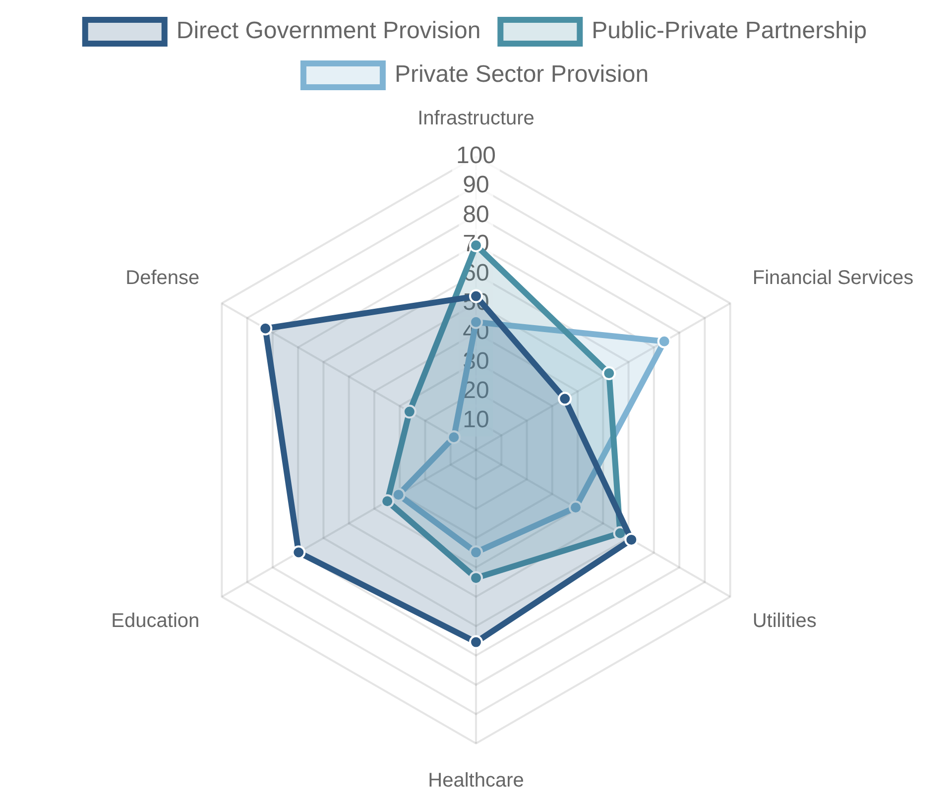
The Role of Government in Economic Development
Market Failures and Government Intervention
Information asymmetries
- Imperfect information leading to suboptimal market outcomes
Externalities
- Social costs/benefits not reflected in market prices
Public goods
- Non-excludable, non-rivalrous goods underproduced by markets
Natural monopolies
- High fixed costs leading to inefficient competition
Spectrum of Public-Private Involvement
Direct provision
- Government as owner and operator
Regulated private provision
- Private ownership with public oversight
Public-private partnerships
- Shared responsibilities and risks
Historical Evolution
Market-based solutions
- Government creating enabling environment
Post-WWII era
- State-led development and industrialization
1980s-1990s
- Privatization wave and market liberalization
2000s-present
- Mixed models and renewed state activism

Slide 4




Key Concepts and Definitions
State-Owned Enterprises (SOEs)
Public-Private Partnerships (PPPs)
Definition:
Business entities established, owned, and controlled by the government to undertake commercial activities.
Definition:
Contractual arrangements between public and private entities for the delivery of infrastructure or services.
Ownership:
Majority or full government ownership
Structure:
Long-term contracts (typically 20-30 years)
Objectives:
Commercial and non-commercial goals
Risk allocation:
Shared between public and private sectors
Governance:
Board appointed by government officials
Financing:
Private capital with potential public support
Sectors:
Utilities, transportation, energy, finance
Value for money:
Efficiency gains vs. higher capital costs
Development Banks
Infrastructure Financing
Definition:
Financial institutions designed to provide capital for economic development projects and address market failures.
Definition:
Mechanisms to fund the development, operation, and maintenance of physical and social infrastructure assets.
Mandate:
Economic development and market gap filling
Characteristics:
Long-term, capital-intensive investments
Funding:
Government capital, bonds, multilateral sources
Sources:
Public budgets, debt, private investment, user fees
Instruments:
Loans, guarantees, equity, technical assistance
Structures:
Project finance, corporate finance, blended finance
Focus:
Infrastructure, SMEs, innovation, sustainability
Challenges:
Risk allocation, regulatory certainty, bankability

Slide 5

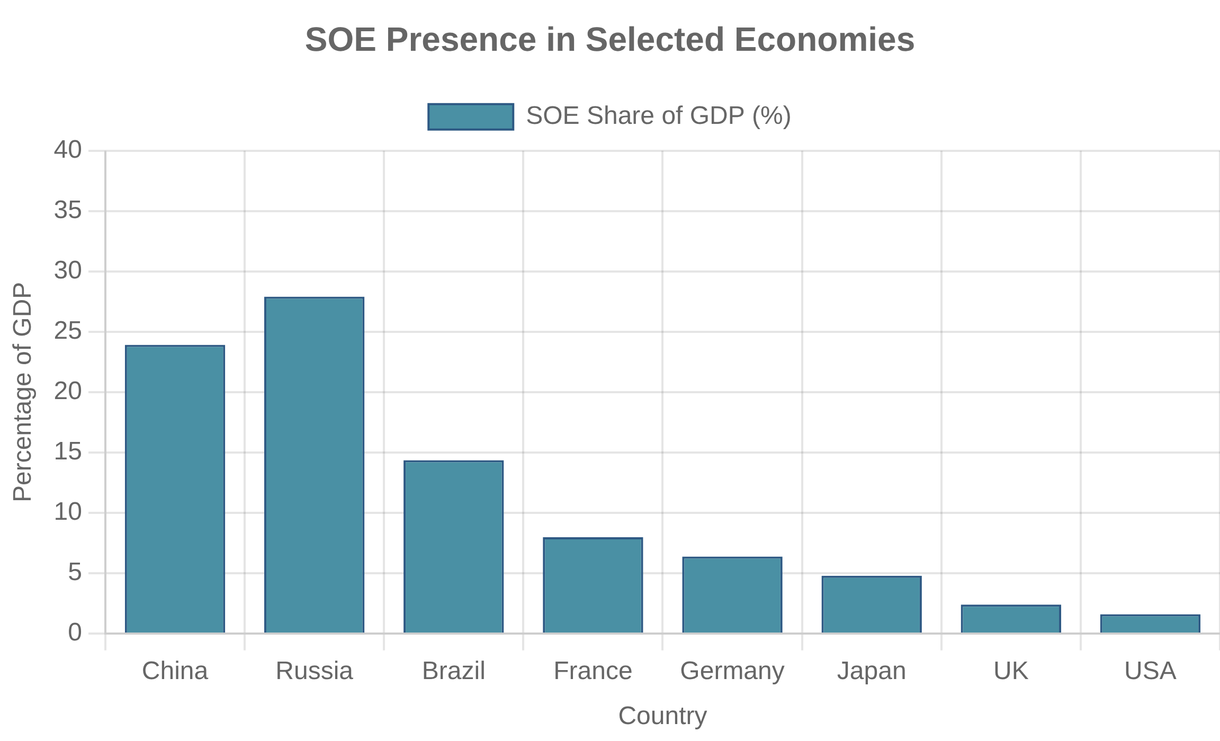
Global Context and Comparative Approach
Different Models Across Countries
Emerging vs. Developed Economy Approaches
Anglo-Saxon Model
- Market-oriented, limited state ownership
Institutional capacity
- Governance quality and regulatory frameworks
Continental European Model
- Mixed economy with strategic state participation
Capital market development
- Access to private financing
East Asian Developmental State
- State-guided industrialization
Risk perception
- Country risk premiums and investment barriers
State Capitalism
- Extensive SOE presence in strategic sectors
Development priorities
- Basic infrastructure vs. advanced services
Key Lessons from International Experience
SOE Governance
PPP Success Factors
Development Finance
Clear ownership policy
Robust project preparation
Clear mandate and focus
Professional boards
Appropriate risk allocation
Sound governance
Transparency and disclosure
Financial sustainability
Institutional capacity
Competitive neutrality
Complementarity with markets
Competitive procurement

Slide 6

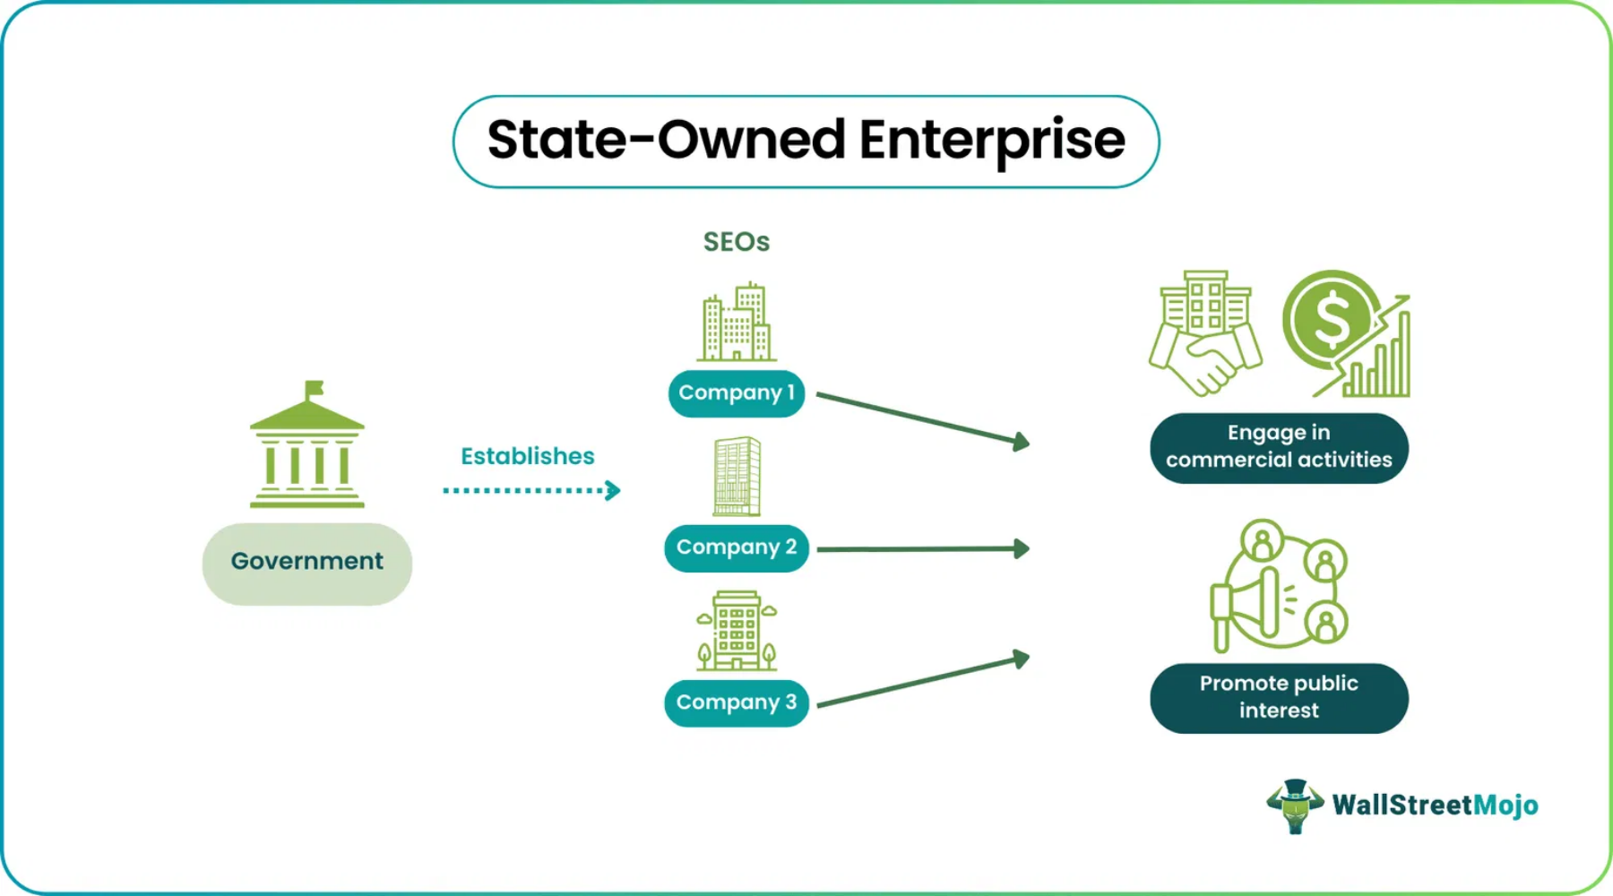
Introduction to State-Owned Enterprises
Definition and Characteristics
Legal entities
established by government for commercial activities
Government ownership
(full or majority) and control
Dual objectives
: commercial performance and public policy goals
Rationale for State Ownership
Natural monopolies
- Network industries with high fixed costs
Strategic sectors
- National security and resource control
Market failures
- Externalities and public goods
Global Prevalence and Importance
"State-owned enterprises remain significant economic actors in many countries and are often concentrated in sectors with economy-wide importance."
Economic weight
: SOEs account for 10% of global GDP
Employment
: Major employers in many countries
International presence
— OECD Guidelines
: 22% of Fortune Global 500 companies are SOEs
Key Sectors
Energy and utilities
- Electricity, gas, water
Transportation
- Railways, airlines, ports
Financial services
- Development and commercial banks

Slide 7

Historical Evolution of SOEs
Post-War Development Models
1945-1970s:
Widespread nationalization and SOE creation
1970s
1990s
Keynesian economics
supporting state intervention
Oil crisis and expansion of state control in energy sector
Post-Soviet privatization and Washington Consensus
Import substitution
industrialization in developing countries
Public utilities
as natural monopolies under state control
Socialist and Mixed Economy Approaches
Post-war nationalization wave in Europe and developing world
Soviet model:
Central planning and state ownership
Thatcher/Reagan era privatization begins
Rise of new state capitalism and SOE reforms
European mixed economies:
Strategic sectors under state control
1950s
1980s
2000s+
East Asian developmental states:
State-guided industrialization
Latin American state capitalism:
SOEs as development engines
Privatization Waves and Reforms
1980s UK privatization:
Thatcher's market-oriented reforms
1990s global wave:
Post-Soviet transitions and Washington Consensus
SOE reforms:
Corporatization, partial privatization, governance changes
Post-2008 trends:
Renewed state activism and strategic SOEs

Slide 8

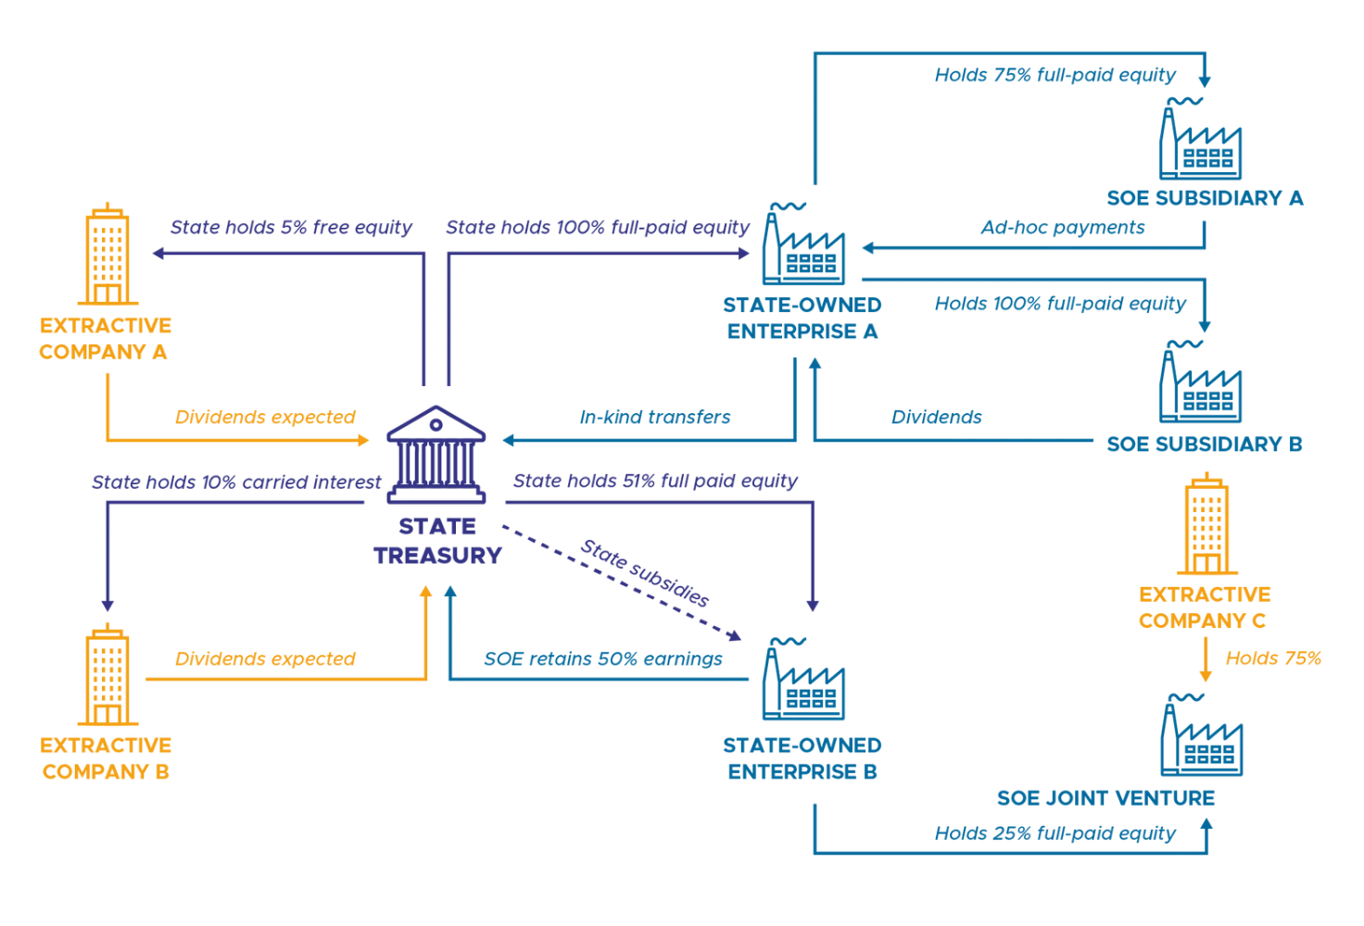
The Chinese SOE Model
Central Role in China's Economic Development
Historical foundation:
SOEs as legacy of planned economy
Reform without privatization:
Improving efficiency while maintaining state control
Strategic pillar:
SOEs as instruments of industrial policy
Global competitors:
Chinese SOEs among world's largest companies
Dual-Track System and Gradual Reforms
Coexistence:
State and private sectors operating in parallel
Incremental approach:
"Crossing the river by feeling the stones"
SOE Classification and Hierarchy
Experimentation:
Special economic zones and pilot reforms
Central SOEs:
Managed by central SASAC, focus on strategic industries
Pragmatism:
Results-oriented rather than ideologically driven
Local SOEs:
Managed by provincial/municipal governments
Chinese SOEs: Key Statistics
Strategic vs. commercial:
Different levels of state control
~100,000
96
Listed subsidiaries:
Many SOEs have publicly traded components
Total SOEs (all levels)
Central SOEs under SASAC
Party-State Control Mechanisms
30%
20%
SASAC:
Share of GDP
Share of urban employment
State-owned Assets Supervision and Administration Commission
Party committees:
Parallel governance structure within SOEs
Cadre rotation:
Movement of executives between SOEs and government
Policy coordination:
Alignment with Five-Year Plans and industrial policy

Slide 9

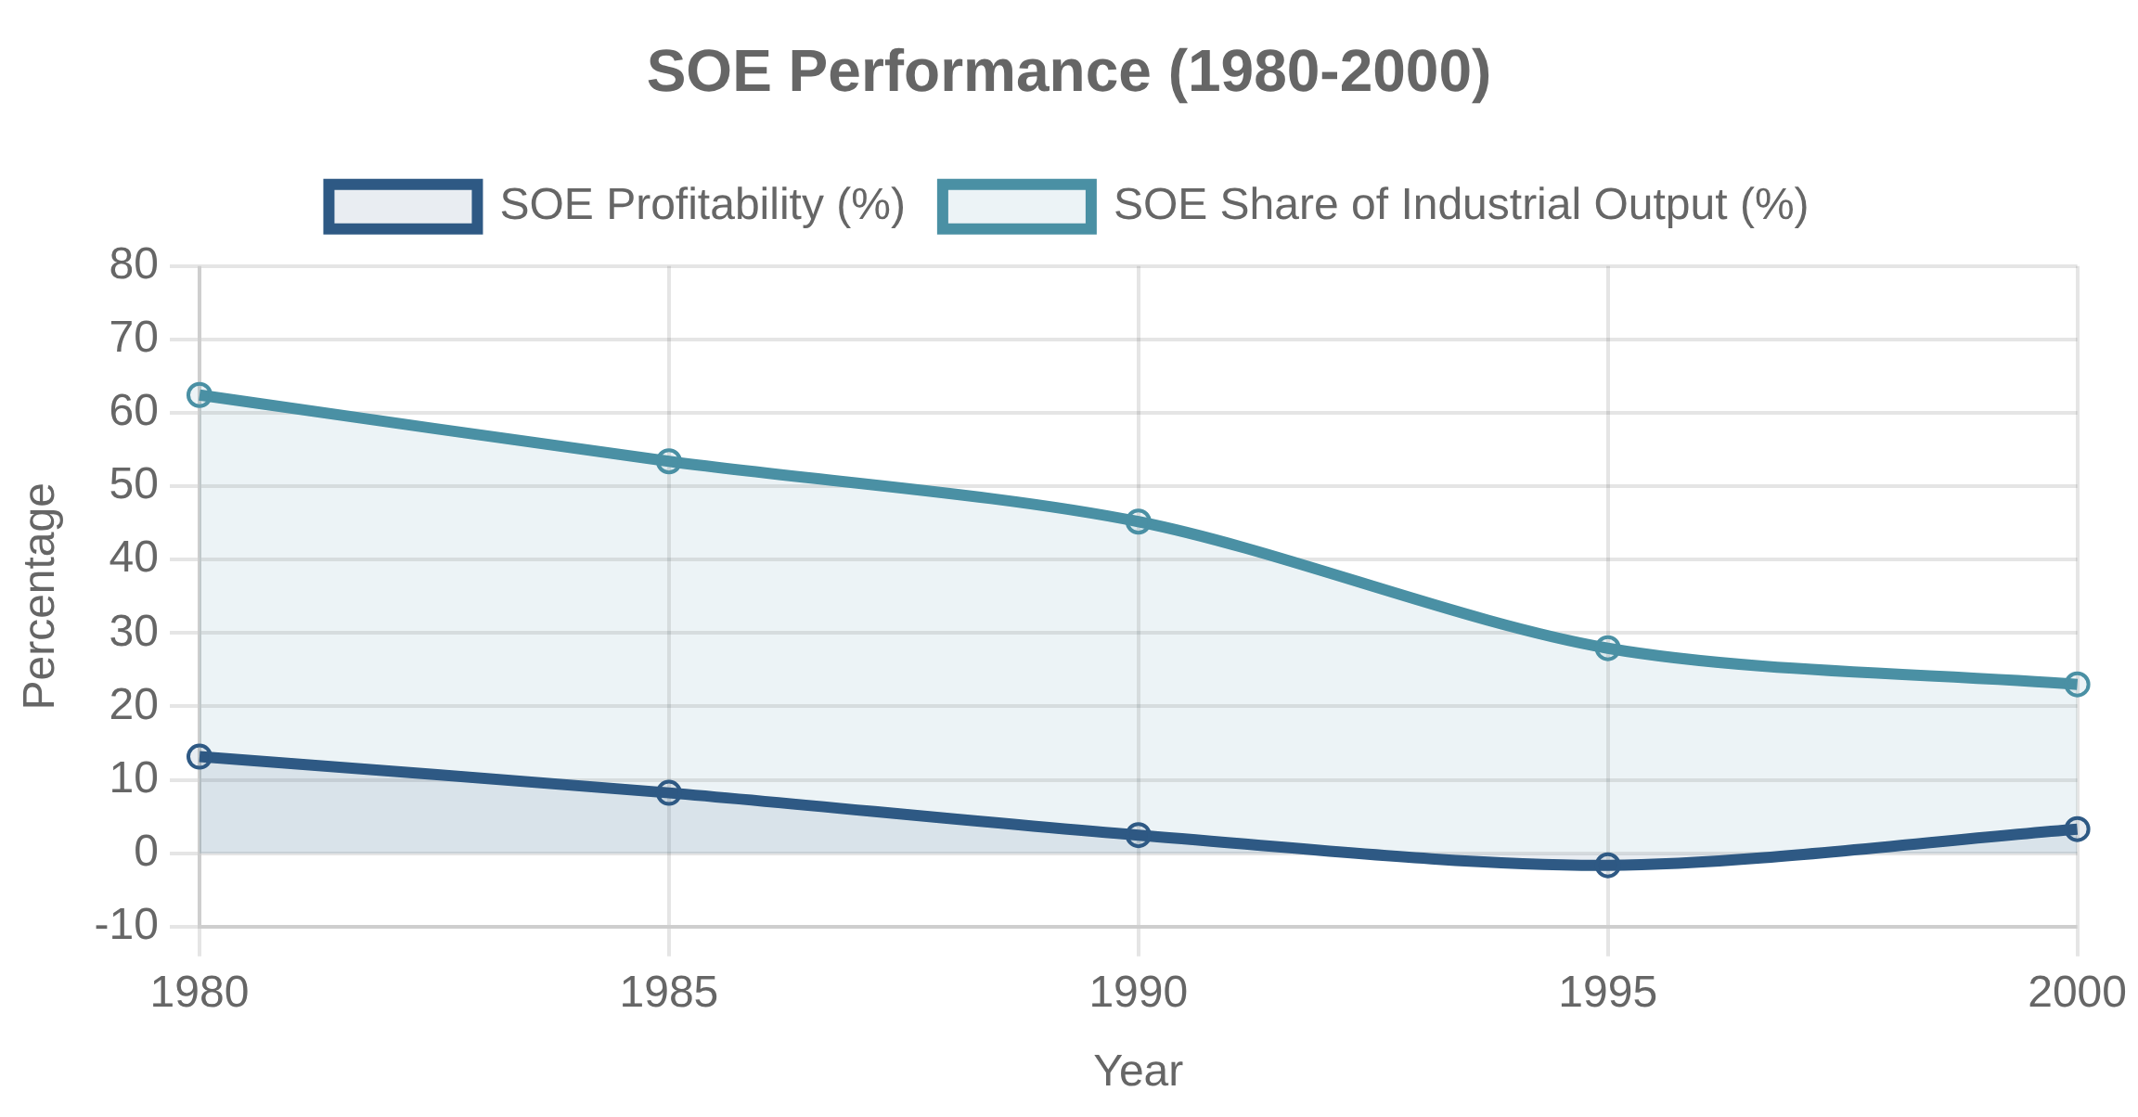
Chinese SOE Reforms (1980s-1990s)
Contract Responsibility System
Corporatization and Governance Changes
Enterprise autonomy:
Greater decision-making power for managers
Company Law (1993):
Legal framework for corporate governance
Profit retention:
Allowing SOEs to keep portion of profits
Shareholding reforms:
Converting SOEs into limited liability companies
Performance contracts:
Targets negotiated with government
Managerial incentives:
Bonuses tied to enterprise performance
Board structures:
Introduction of boards of directors
Minority listings:
Partial IPOs while maintaining state control
1978-84
Expanded Autonomy
Initial profit retention schemes and managerial authority
1984-92
Contract Responsibility System
Performance contracts between SOEs and government agencies
1993-97
Modern Enterprise System
Corporatization and clarification of property rights
1997-03
"Grasp the Large, Let Go of the Small"
Market-Oriented Reforms
Restructuring large SOEs, privatizing smaller ones
Price liberalization:
Gradual shift from planned to market prices
Competition:
Entry of non-state firms into previously monopolized sectors
Hard budget constraints:
Reducing automatic bailouts and subsidies
Commercial banking:
Shift from fiscal grants to bank loans

Slide 10

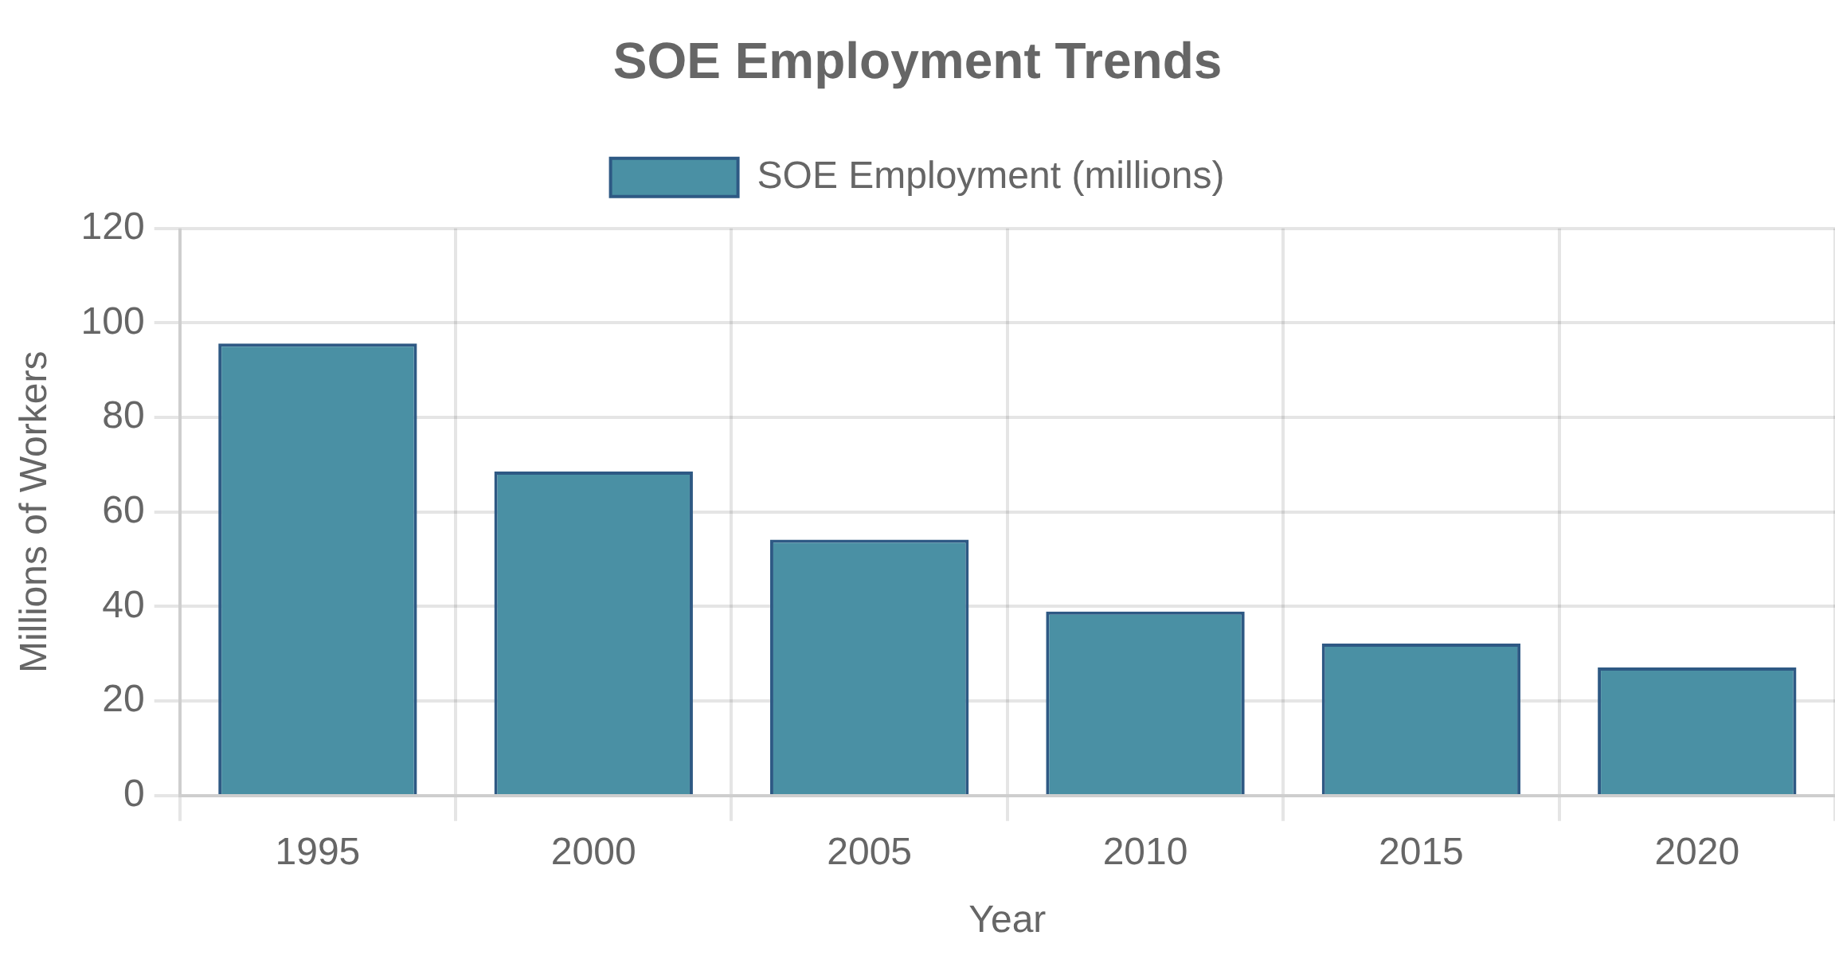
Chinese SOE Restructuring (2000s-Present)
Large-Scale Downsizing and Employment Reduction
Listed Companies and Mixed Ownership
Partial IPOs:
Listing high-quality assets while maintaining control
Massive layoffs:
Over 40 million SOE workers laid off (1995-2005)
Multiple stock markets:
Shanghai, Shenzhen, Hong Kong, overseas
Social safety net:
Re-employment centers and welfare programs
Mixed ownership:
Private capital in state-controlled firms
Concentration:
Closure or merger of small and medium SOEs
Temasek model:
Professional state investment companies
Productivity gains:
Significant efficiency improvements
Key Policy Milestones
2003: SASAC Establishment
Creation of State-owned Assets Supervision and Administration Commission to centralize ownership functions
2013: Third Plenum Reforms
Mixed ownership, market-oriented operations, and modern corporate governance
2015: SOE Classification Reform
Dividing SOEs into commercial and public welfare categories with different performance metrics
Strategic Sector Consolidation
"Commanding heights" strategy:
Focus on strategic industries
2020: Three-Year Action Plan
Mergers and acquisitions:
Creating national champions
Enhancing competitiveness, innovation capacity, and control mechanisms
Global expansion:
Outward investment and acquisitions
Belt and Road Initiative:
SOEs as policy implementation vehicles

Slide 11

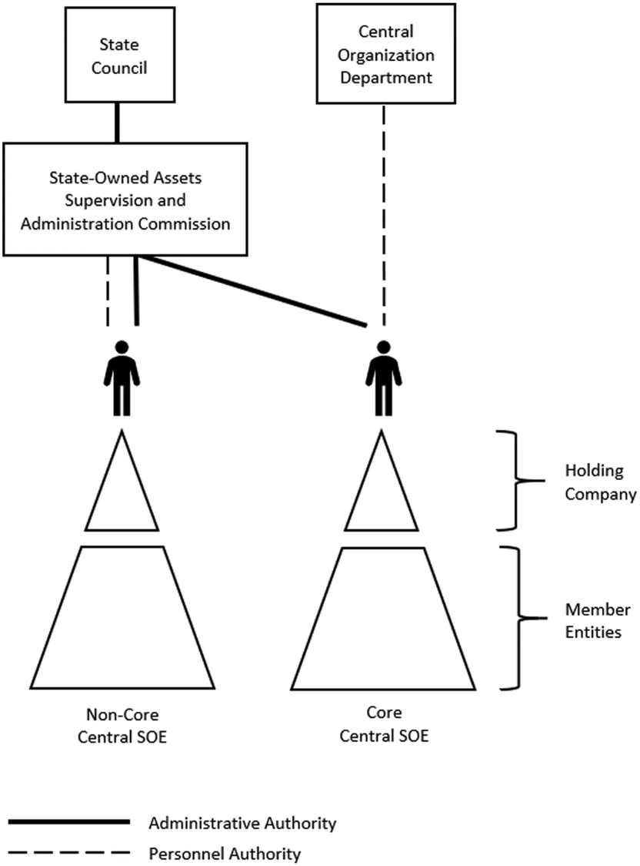




SOE Governance Structures
Board Composition and Oversight
Party-State Control Mechanisms
Shareholder representation:
Government agencies as owners
Chinese model:
Party committees embedded in governance
Independent directors:
Varying levels across countries
Ministerial control:
Direct oversight by sector ministries
Employee representation:
Common in European models
Centralized ownership:
Specialized agencies (e.g., SASAC)
Board committees:
Audit, compensation, nomination
Golden shares:
Special voting rights despite minority ownership
Governance Models
Centralized Model
Single ownership entity exercises shareholder rights for all SOEs (e.g., Singapore's Temasek, Hungary's MNV)
Dual Model
Ownership split between central finance ministry and sector ministries (e.g., France, South Korea)
Decentralized Model
Multiple ministries or agencies exercise ownership rights (e.g., India, many developing countries)
Professional Management vs. Political Control
Management autonomy:
Operational independence vs. oversight
Hybrid Model
Executive appointment:
Merit-based vs. political selection
Combination of centralized coordination and sectoral expertise (e.g., China's SASAC system)
Performance incentives:
Commercial vs. policy objectives
Accountability mechanisms:
Market discipline vs. administrative control

Slide 12

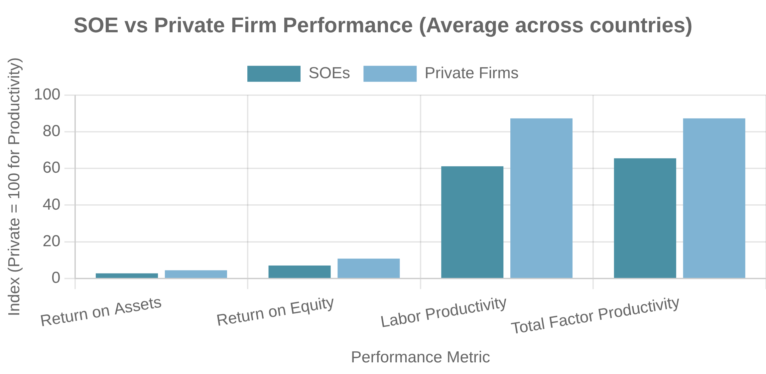




SOE Performance and Efficiency
Productivity Comparisons with Private Firms
Soft Budget Constraints
Efficiency gap:
SOEs typically 20-40% less productive than private counterparts
Concept:
Expectation of government bailouts reducing financial discipline
Sector variation:
Smaller gaps in natural monopolies, larger in competitive markets
Manifestations:
Preferential loans, subsidies, tax benefits, debt forgiveness
Reform impact:
Significant improvements following corporatization and exposure to competition
Consequences:
Overinvestment, excessive risk-taking, inefficient operations
Measurement challenges:
Accounting for policy burdens and non-commercial objectives
Hardening efforts:
Dividend policies, commercial financing, bankruptcy threat
Key Performance Factors
Competitive Environment
Market competition drives efficiency improvements and innovation
Clear Objectives
Explicit commercial and policy goals with performance metrics
Professional Management
Merit-based selection and performance incentives
Innovation and Competitiveness Issues
Transparency and Disclosure
R&D investment:
Often substantial but less efficient conversion to innovation
Financial reporting and accountability mechanisms
Risk aversion:
Bureaucratic processes and fear of failure limiting innovation
Talent attraction:
Challenges competing with private sector for top talent
Exceptions:
Some SOEs as global innovation leaders (e.g., Singapore Airlines, Statoil/Equinor)

Slide 13

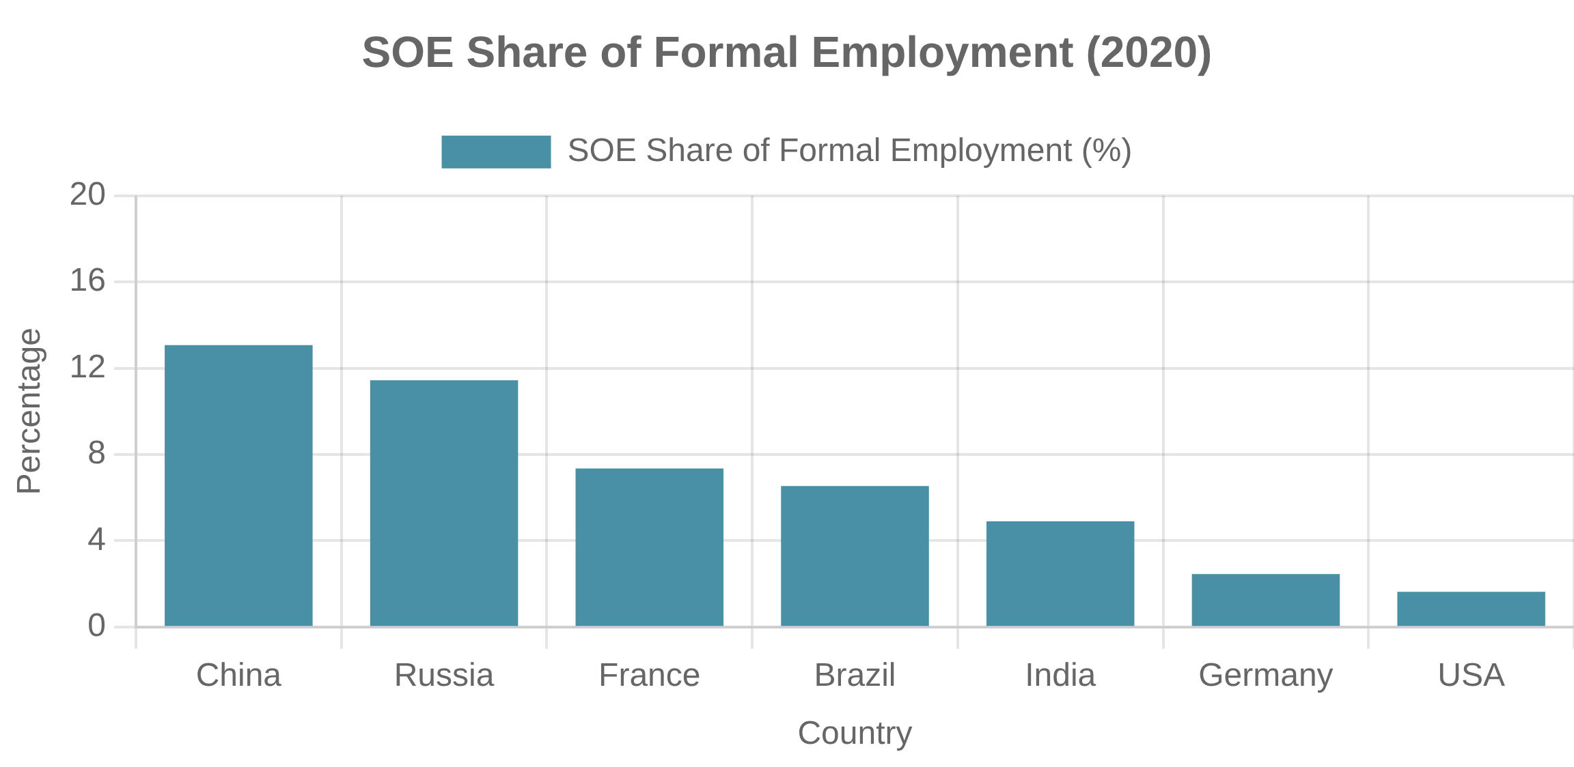
SOE Employment and Social Functions
Job Security and Social Stability
Welfare Provision and Social Services
Employment guarantee:
Traditional "iron rice bowl" job security
Enterprise-Based Welfare
Political importance:
SOE workers as key constituency
Housing, healthcare, education, and pensions provided directly by SOEs, especially in transition economies
Reform challenges:
Balancing efficiency with social stability
Regional impact:
SOEs as anchors in less-developed regions
Universal Service Obligations
Ensuring access to essential services in unprofitable areas (rural electrification, postal service, telecommunications)
Price Controls and Subsidies
Keeping prices below market levels for essential goods and services (energy, water, transportation)
Community Development
Supporting local infrastructure, education, and social services in communities where SOEs operate
Labor Market Implications
Wage premiums:
SOE workers often earn 10-30% more than private sector
Case Study: Chinese SOE Restructuring
Labor mobility:
Lower turnover but reduced market flexibility
China's SOE reforms in the late 1990s led to over 40 million layoffs. To manage social impact, the government created re-employment centers, expanded unemployment insurance, and developed targeted poverty alleviation programs. Despite these efforts, the reforms created significant hardship in industrial cities and contributed to rising inequality.
Skill development:
Training investments but potential skill mismatches
Demographic challenges:
Aging workforce and pension obligations

Slide 14

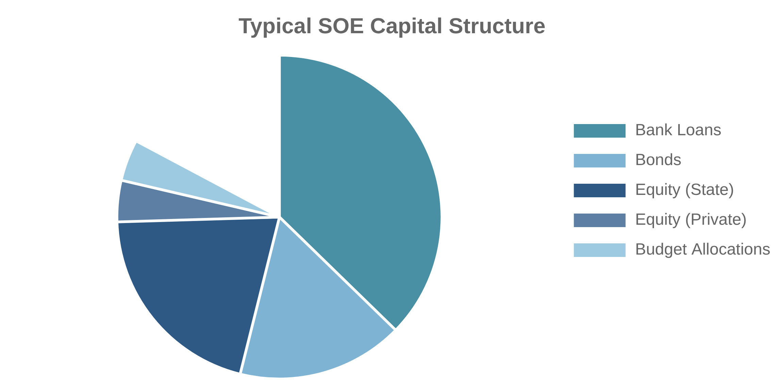
SOE Financing and Capital Structure
State Budget Allocations
Bank Lending and Credit Access
Initial capitalization:
Equity injections at establishment
State-Owned Banks
Operational subsidies:
Ongoing support for policy objectives
Preferential lending to SOEs, often with implicit government guarantees and policy direction
Investment grants:
Funding for specific projects
Fiscal constraints:
Competing demands limiting direct funding
Development Banks
Long-term financing for infrastructure and strategic projects at below-market rates
Commercial Banks
Market-based lending, though often with preferential terms due to perceived lower risk
International Financial Institutions
World Bank, regional development banks providing loans with reform conditions
Capital Market Financing
Partial IPOs:
Listing minority stakes while maintaining control
SOE vs. Private Firm Financing
Corporate bonds:
Debt issuance with implicit state guarantees
Private placements:
Strategic investors and institutional capital
Aspect
SOEs
Private Firms
International listings:
Access to global capital and credibility
Cost of Debt
Lower (implicit guarantees)
Higher (market risk pricing)
Leverage
Often higher
Typically lower
Financing Constraints
Less binding
More binding
Market Discipline
Weaker
Stronger

Slide 15

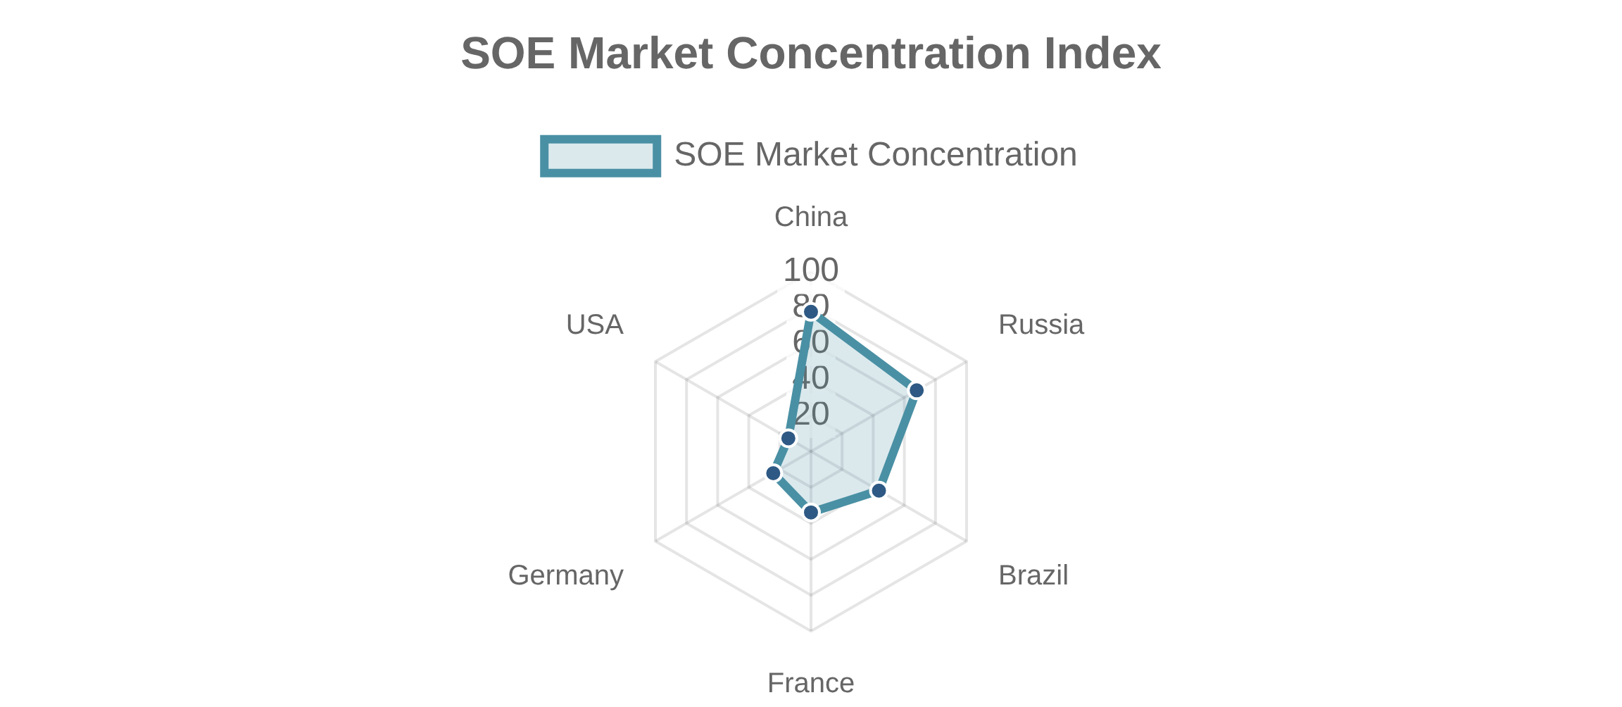
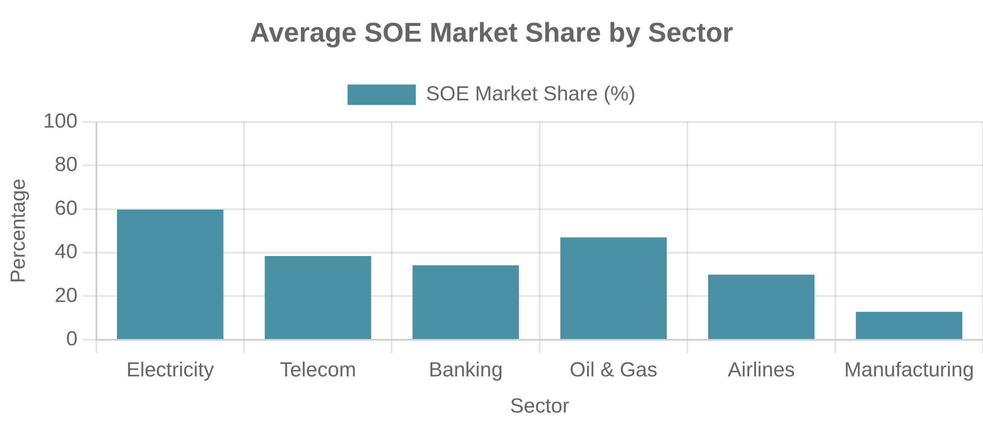
Competition and Market Dynamics
SOE-Private Firm Competition
Market Concentration in Key Sectors
Uneven playing field:
SOEs often enjoy advantages over private competitors
Network industries:
Natural monopoly characteristics in utilities, rail
Strategic sectors:
Defense, energy, telecommunications
Market distortions:
Preferential treatment affecting resource allocation
Financial services:
State banks often dominating credit allocation
Crowding out:
SOE dominance potentially limiting private investment
Antitrust and Competition Policy
SOE Competitive Advantages
Competitive neutrality:
Principle of equal treatment for all enterprises
Preferential Financing
SOE exemptions:
Special treatment under competition law
Lower borrowing costs, easier credit access, implicit guarantees
International dimensions:
Trade disputes over SOE subsidies
Regulatory Preferences
OECD Competitive Neutrality Framework
Favorable licensing, exemptions from certain rules
Equal tax treatment, debt neutrality, regulatory neutrality, and transparent compensation for public service obligations.

Slide 16

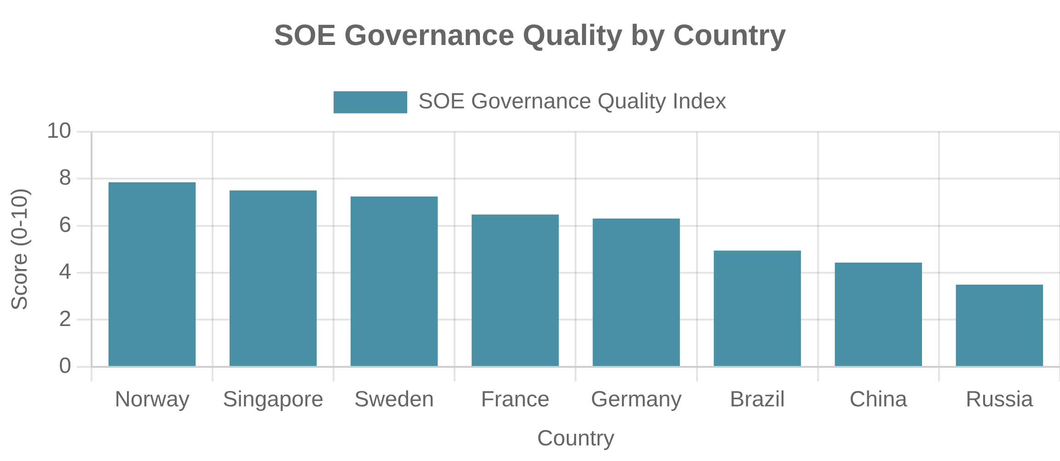
International SOE Comparisons
European SOE Models
Sovereign Wealth Funds and State Investment
France
Germany
Singapore (Temasek)
Norway (GPFG)
Strategic state shareholdings
Federal and regional SOEs
Professional investment company
Resource-based sovereign fund
APE (State Shareholding Agency)
Strong corporate governance
Commercial mandate with long-term focus
Passive investment approach
Mixed ownership in key sectors
Codetermination (worker representation)
Ethical investment guidelines
Strong industrial policy orientation
Active management of portfolio companies
Intergenerational wealth transfer
Public banks (Landesbanken)
Global investments beyond Singapore
Nordic State Capitalism
Professional management:
Arm's length governance with limited political interference
Emerging Economy Approaches
Commercial orientation:
Clear financial targets and performance metrics
Brazil
India
Transparency:
High disclosure standards and accountability
Strategic national champions (Petrobras, BNDES)
Extensive SOE presence ("Public Sector Undertakings")
Competitive markets:
SOEs operating in competitive environments
Mixed ownership with stock market listings
Gradual disinvestment program
Bureaucratic governance model
Development and social mandates
Maharatna/Navratna classification system
Governance reforms after corruption scandals

Slide 17


SOEs in Strategic Sectors
Energy and Utilities
Defense and National Security
Energy
Defense Industries
State control for energy security and resource sovereignty.
State ownership to ensure security of supply and protect technologies.
Examples: Saudi Aramco, Gazprom, EDF, State Grid
Examples: AVIC (China), Rostec (Russia), Naval Group (France)
Water and Utilities
Space and Strategic Technologies
Public ownership due to natural monopoly and public health concerns.
Government control of dual-use civilian and military applications.
Examples: Veolia, Singapore PUB, Delhi Jal Board
Examples: ISRO (India), CNSA (China), Roscosmos (Russia)
Transportation and Infrastructure
Strategic Rationales
Railways and Mass Transit
National Security
Market Failures
Control over critical infrastructure and resources
Addressing natural monopolies and public goods
State ownership for network coordination and strategic connectivity.
Examples: Deutsche Bahn, SNCF, Indian Railways
Strategic Autonomy
Industrial Policy
Reducing dependence on foreign suppliers
Developing strategic industries and capabilities

Slide 18

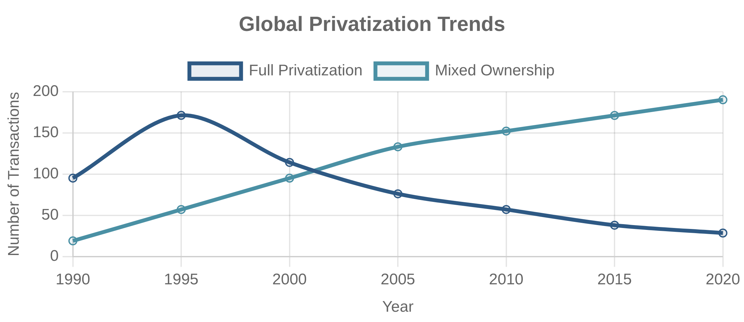
Privatization vs. Reform Approaches
Full Privatization Models
Continued State Control with Reforms
Full Privatization
Corporatization
Complete transfer of ownership and control from state to private sector through share offerings, asset sales, or management buyouts.
Restructuring SOEs as corporations with commercial orientation while maintaining state ownership, often with independent boards and market-based performance metrics.
Examples: UK utilities (1980s-90s), Eastern European mass privatizations (1990s)
Examples: Singapore's Temasek holdings, Nordic SOEs
Partial Privatization and Mixed Ownership
Comparative Outcomes
Mixed Ownership
Dimension
Full Privatization
Mixed Ownership
State Reform
Efficiency
Often higher
Improved
Variable
State retains significant ownership stake while introducing private capital through IPOs, strategic investors, or employee ownership.
Investment
Market-driven
Balanced
Policy-influenced
Examples: China Mobile, Petrobras (Brazil), Enel (Italy)
Public Service
Requires regulation
Often maintained
Prioritized
Political Control
Minimal
Partial
Significant
Implementation
Complex, irreversible
Flexible, gradual
Easier politically
Key Success Factors
Institutional capacity:
Regulatory frameworks and governance
Sequencing:
Reforms before ownership changes
Competition:
Market structure more important than ownership
Transparency:
Clear objectives and performance monitoring

Slide 19

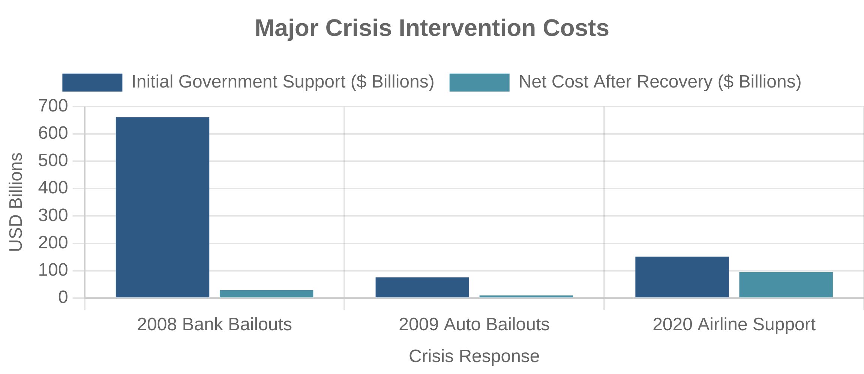
SOE Crisis Response and Bailouts
Financial Crisis Interventions
Airline Industry Support
Bank Nationalizations (2008-09)
COVID-19 Airline Support (2020)
Governments in the US, UK, and Europe took ownership stakes in failing banks during the global financial crisis to prevent systemic collapse and protect depositors.
Governments worldwide provided over $160 billion in support to airlines through loans, equity investments, wage subsidies, and nationalization to prevent industry collapse during pandemic travel restrictions.
Outcome: Most banks returned to private ownership after stabilization, with governments often recovering investments.
Outcome: Prevented widespread bankruptcies but created significant public debt and potential market distortions.
Automotive Industry Bailouts
Policy Considerations
Temporary vs. permanent:
Crisis interventions as temporary measures or long-term state ownership
GM and Chrysler Rescue (2009)
Conditionality:
The US government provided $80 billion in assistance to GM and Chrysler through loans, equity investments, and managed bankruptcy processes to prevent collapse of the auto industry.
Attaching reform requirements, executive compensation limits, and environmental conditions to support
Moral hazard:
Balancing rescue of systemically important firms against creating expectations of future bailouts
Outcome: Both companies restructured successfully, though the government took a $10.2 billion loss on its investment.
Exit strategies:
Planning for eventual return to private ownership or continued state involvement
Bailout Design Principles
Protect taxpayer interests through appropriate compensation (equity stakes, warrants)
Ensure shared sacrifice among stakeholders (shareholders, creditors, management)
Maintain market discipline through commercial terms and clear exit timelines
Address underlying structural issues, not just provide temporary relief
Maintain transparency and accountability in decision-making and implementation

Slide 20

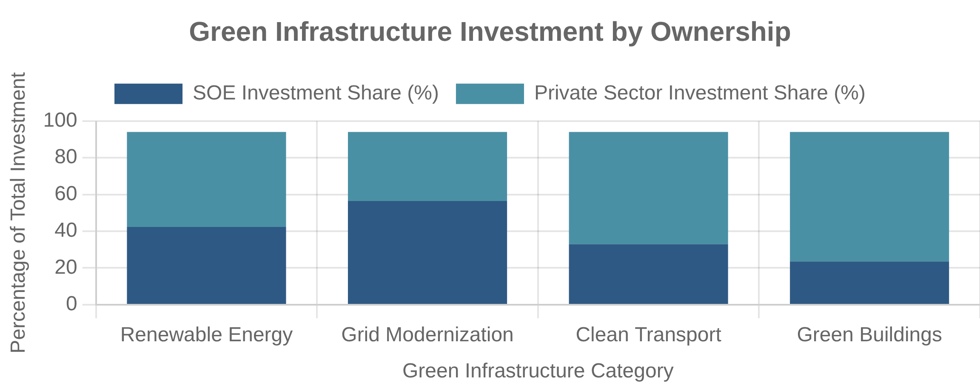
Future of SOEs in Modern Economies
Digital Transformation and SOEs
Geopolitical Considerations
Digital Challenges
Strategic Competition
SOEs face pressure to modernize legacy systems and compete with agile digital disruptors, requiring cultural change and significant investment.
Rising tensions and supply chain vulnerabilities drive renewed interest in SOEs as instruments of economic sovereignty in critical sectors.
Climate Change and Green Transition
Emerging SOE Models
Mission-oriented SOEs:
Focused on specific challenges like climate change
Dual Role in Energy Transition
Hybrid governance:
SOEs must decarbonize while maintaining energy security, with state ownership enabling long-term green investments.
Combining state direction with private sector discipline
Collaborative ecosystems:
SOEs as orchestrators of innovation networks
Policy Implications
Governance innovation:
New models balancing autonomy with accountability
Competitive neutrality:
Ensuring level playing field with private firms
Performance measurement:
Evaluating commercial and public value objectives
Beyond Ideology: Pragmatic Approaches
The future lies in pragmatic approaches leveraging strengths of both public and private ownership to address complex economic, social, and environmental challenges.

Slide 21


PPP Fundamentals
Definition and Core Principles
Risk Sharing Between Sectors
What is a Public-Private Partnership?
A long-term contract between a public entity and a private party for the design, financing, construction, operation, and/or maintenance of public infrastructure or services, with significant risk transfer to the private sector and performance-based payment mechanisms.
Long-term Partnership
Typically 20-30 year contracts covering multiple project lifecycle phases
Value for Money Concept
Definition:
Net benefit of using PPP over traditional procurement
Risk Sharing
Components:
Risk transfer, whole-life costing, private sector efficiency
Allocation of risks to the party best able to manage them
Assessment:
Public Sector Comparator vs. PPP reference model
Beyond price:
Service quality, innovation, and timely delivery
Output Specification
Key Distinctions
Focus on service outcomes rather than input requirements
Not privatization:
Public ownership with private delivery
Not outsourcing:
Long-term, integrated approach
Not traditional procurement:
Performance-based payment
Not deregulation:
Structured contractual framework

Slide 22

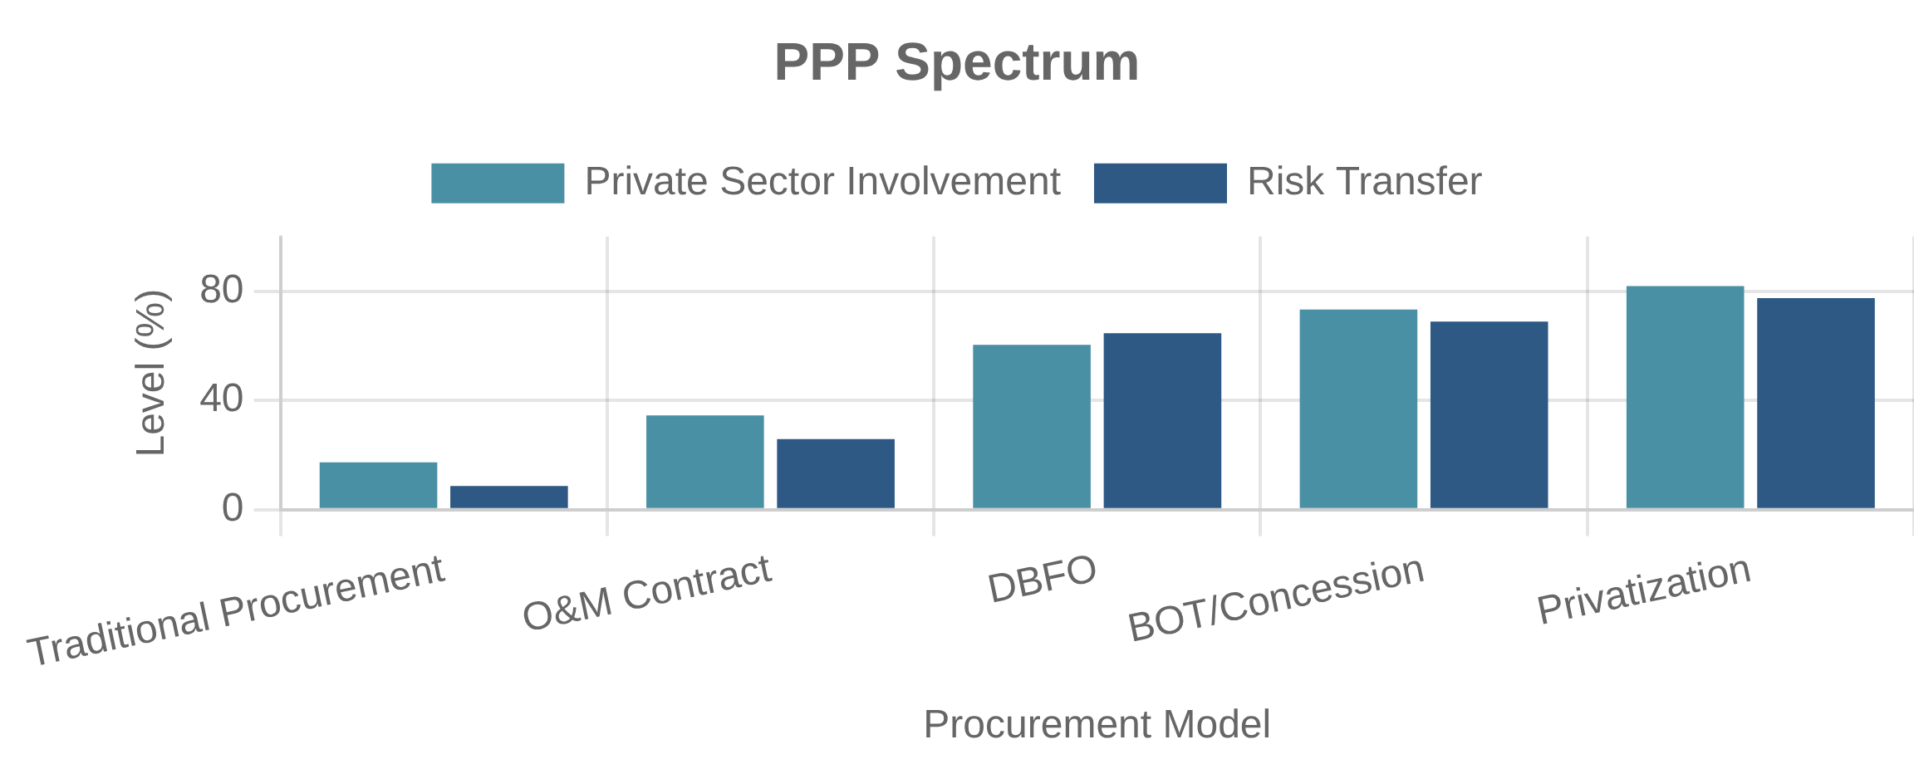
PPP Models and Structures
Build-Operate-Transfer (BOT)
Concession Models
BOT
Build-Operate-Transfer
ROT
Rehabilitate-Operate-Transfer
Private partner builds infrastructure, operates it for a fixed concession period to recover investment and earn returns, then transfers ownership to the public sector.
Private partner renovates existing infrastructure, operates it for a concession period, then returns it to the public sector. Used for aging assets requiring significant upgrades.
Examples: Toll roads, power plants, water treatment facilities
Examples: Existing highways, ports, airports
Design-Build-Finance-Operate (DBFO)
Comparison of Key Models
DBFO
Feature
BOT
DBFO
Concession
Design-Build-Finance-Operate
Revenue Source
User fees
Government payments
User fees
Private partner designs, constructs, finances, and operates infrastructure, with payment based on availability and performance rather than user fees.
Demand Risk
Private
Public
Private
Examples: Hospitals, schools, government buildings, prisons
Asset Ownership
Public after transfer
Public throughout
Public throughout
Typical Duration
20-30 years
25-35 years
25-99 years
Common Sectors
Transport, Energy
Social infrastructure
Utilities, Transport
Other Common Variants
BOOT:
Build-Own-Operate-Transfer (private ownership during concession)
BOO:
Build-Own-Operate (no transfer to public sector)
O&M:
Operation and Maintenance (no construction component)
DBFM:
Design-Build-Finance-Maintain (focused on asset condition)

Slide 23

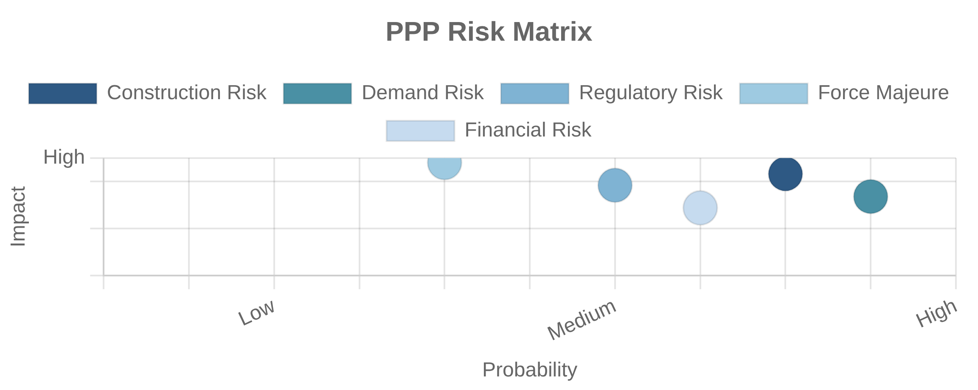
PPP Risk Allocation
Construction and Technical Risks
Political and Regulatory Risks
Construction Risk
Regulatory Risk
Risks related to cost overruns, delays, defects, and technical failures during the construction phase.
Risk of changes in laws, regulations, or government policies that affect project economics or operations.
Allocation:
Allocation:
Demand and Revenue Risks
Other Key Risk Categories
Financial risks:
Interest rate fluctuations, currency exchange, inflation
Demand Risk
Environmental risks:
Contamination, climate events, environmental compliance
Risk that actual usage or demand for services will be different from projections, affecting revenue streams.
Social risks:
Public opposition, labor disputes, community relations
Allocation:
Force majeure:
Natural disasters, war, terrorism, pandemics
Risk Mitigation Instruments
Contractual mechanisms:
Compensation events, relief events, step-in rights
Insurance:
Construction, liability, business interruption, political risk
Financial instruments:
Guarantees, hedging, reserve accounts
Multilateral support:
Political risk insurance, partial risk guarantees
Risk Allocation Principles
Allocate risks to the party best able to manage them
Consider party's ability to bear the risk at lowest cost
Avoid transferring risks that private sector cannot control
Ensure risk pricing is transparent and competitive
Document allocation clearly in contract documents

Slide 24

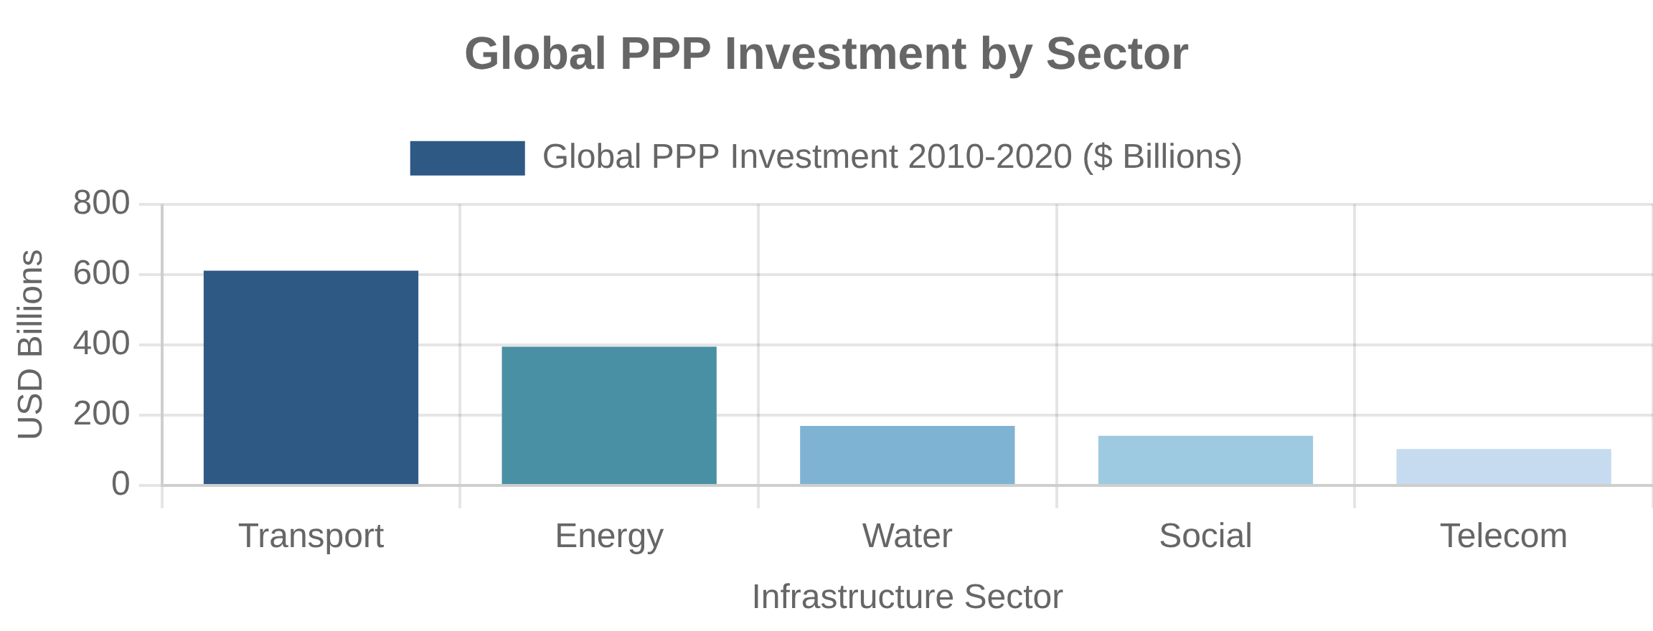
Infrastructure PPPs
Transportation Projects
Energy and Utilities
Transportation Infrastructure
Energy Infrastructure
Most mature PPP sector with established revenue models and risk allocation. Projects involve significant upfront capital with long operational periods.
Evolved from traditional power generation to include renewables and smart grids. Typically has stable revenue through power purchase agreements or regulated tariffs.
Examples: Toll roads, bridges, airports, ports, rail systems
Examples: Power plants, renewable energy, transmission networks
Water and Sanitation
Regional Variations
Water Infrastructure
Developed markets:
Complex projects, social infrastructure focus
Addresses critical public health needs but faces affordability concerns, regulatory requirements, and aging infrastructure challenges.
Emerging markets:
Basic infrastructure with multilateral support
Low-income countries:
Simpler models with greater public support
Examples: Water treatment plants, distribution networks, wastewater systems
Emerging Trends
Climate-resilient infrastructure:
Adaptation measures in design
Smart infrastructure:
Digital technologies and IoT solutions
Bundled projects:
Packaging smaller assets to achieve scale
Success Factors for Infrastructure PPPs
Robust project preparation and feasibility studies
Clear regulatory framework and contract enforcement
Appropriate risk allocation based on sector characteristics
Transparent procurement and stakeholder engagement

Slide 25

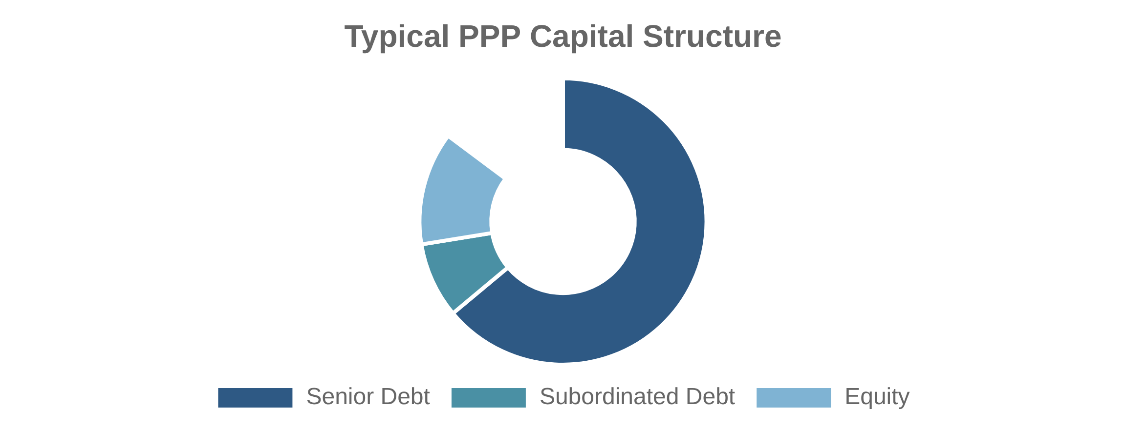
PPP Financing Mechanisms
Project Finance Structures
Debt and Equity Arrangements
Special Purpose Vehicle (SPV)
Debt Financing
A dedicated legal entity created specifically to develop, finance, and operate the PPP project. The SPV isolates project risks and allows for structured financing arrangements with multiple stakeholders.
Typically 70-90% of project costs, provided through commercial bank loans, bonds, or multilateral lending. Limited or non-recourse to sponsors, with loan terms matched to project lifecycle and cash flows.
Equity Investment
10-30% of project costs, provided by project sponsors, infrastructure funds, or institutional investors. First-loss position with higher returns to compensate for greater risk exposure.
Financing Sources Comparison
Source
Advantages
Limitations
Government Support Mechanisms
Commercial Banks
Project expertise, flexible terms
Shorter tenors, higher rates
Viability Gap Funding:
Direct grants to make projects financially viable
Minimum Revenue Guarantees:
Bond Markets
Longer tenors, fixed rates
Less flexibility, rating requirements
Floor on project revenue to mitigate demand risk
Availability Payments:
Performance-based payments regardless of usage
Multilateral Banks
Lower rates, longer tenors
Complex procedures, conditions
Tax Incentives:
Reduced tax burden to improve project economics
Institutional Investors
Long-term perspective, scale
Risk aversion, liquidity needs

Slide 26

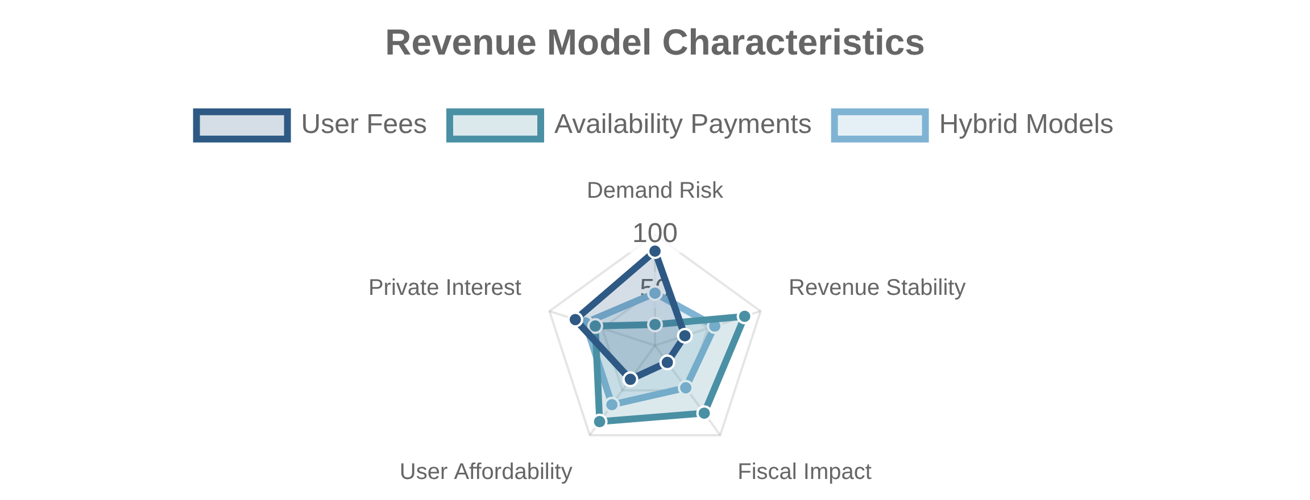
Revenue Models in PPPs
User Fees and Tolls
Shadow Tolls and Hybrid Models
Direct User Charges
Hybrid Payment Mechanisms
Private partner collects fees directly from users of the infrastructure or service. Revenue risk is primarily borne by the private partner, with returns dependent on usage levels and willingness to pay.
Combines elements of user fees and government payments. Shadow tolls are government payments based on usage levels, while hybrid models may include minimum revenue guarantees or usage-based supplements to availability payments.
Examples: Toll roads, airports, ports, water/electricity utilities
Examples: Shadow toll roads, water concessions with subsidized tariffs
Availability Payments
Revenue Model Comparison
Government Payments
Model
Demand Risk
Fiscal Impact
Best For
Government makes regular payments to the private partner based on asset availability and performance standards, regardless of usage levels. Demand risk remains with the public sector.
User Fees
Private
Low
Economic infrastructure
Examples: Schools, hospitals, government buildings, prisons
Availability
Public
High
Social infrastructure
Shadow Tolls
Shared
Medium
Transport with affordability concerns
Hybrid
Shared
Medium
Complex projects with uncertain demand
Key Considerations
Affordability:
User ability and willingness to pay
Fiscal space:
Government capacity for long-term commitments
Risk allocation:
Appropriate sharing of demand risk
Incentives:
Alignment with service quality and efficiency
Flexibility:
Adaptation to changing conditions over time

Slide 27

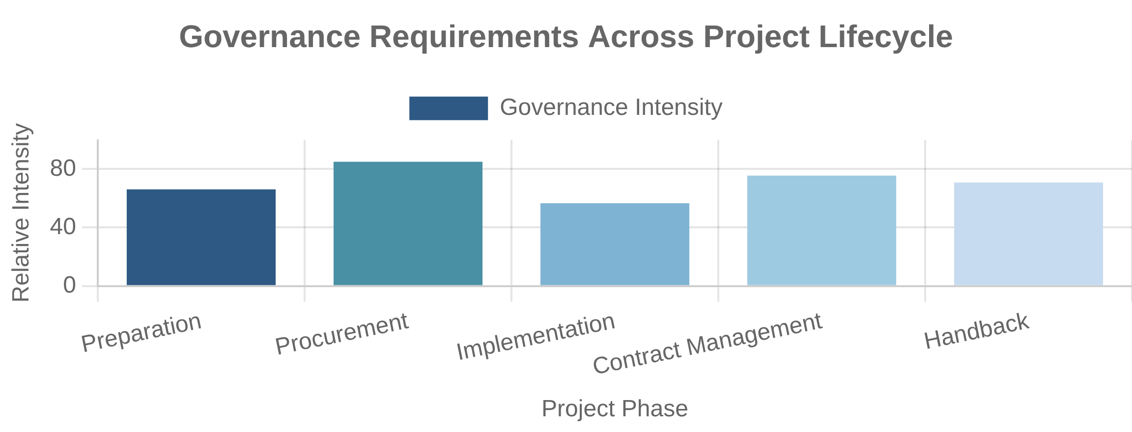
PPP Governance and Contracts
Contract Design and Management
Dispute Resolution Mechanisms
Contract Design
Dispute Resolution
PPP contracts must balance completeness with flexibility over long durations. Key provisions include performance specifications, payment mechanisms, risk allocation, change procedures, and termination provisions.
Long-term PPP contracts require robust dispute resolution mechanisms, including structured escalation procedures, expert determination, mediation, arbitration, and as a last resort, litigation.
Performance Monitoring
Key Contract Documents
Document
Purpose
Monitoring Systems
Effective monitoring requires clear metrics, regular reporting, independent verification, and appropriate incentives through payment deductions or bonuses linked to performance outcomes.
Project Agreement
Core contract between government and private partner
Service Specifications
Detailed performance requirements and standards
Payment Mechanism
Formula and procedures for calculating payments
Direct Agreement
Lenders' step-in rights and government obligations
Shareholders' Agreement
Governance of the project company (SPV)
Institutional Framework
PPP units:
Specialized government agencies providing expertise and standardization
Regulatory bodies:
Independent oversight of service standards and pricing
Contract management teams:
Dedicated resources for ongoing monitoring
Transparency mechanisms:
Public disclosure of contracts and performance

Slide 28

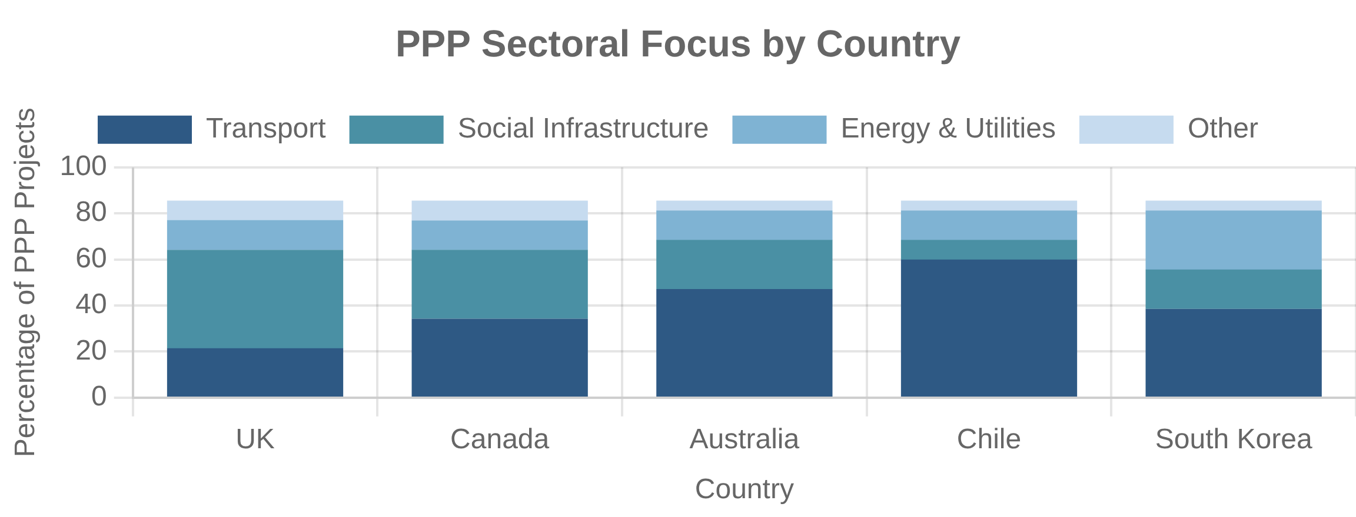
International PPP Experiences
UK Private Finance Initiative (PFI)
Australian PPP Model
United Kingdom
Australia
Pioneered the modern PPP model in the 1990s with the Private Finance Initiative (PFI). Focused on availability-based payment models for social infrastructure. Reformed in 2012 as PF2 to address criticisms, then largely discontinued in 2018 due to concerns about value for money and fiscal risks.
Developed sophisticated PPP frameworks at state level, particularly in Victoria and New South Wales. Pioneered the Public Sector Comparator methodology for value for money assessment. Notable for transport infrastructure and social infrastructure projects with innovative risk allocation.
Canadian P3 Programs
Emerging Market Approaches
Canada
Chile:
Early adopter in Latin America, successful toll road concessions
South Korea:
Extensive PPP program with government risk-sharing
Developed provincial PPP agencies (e.g., Partnerships BC, Infrastructure Ontario) with standardized processes and documents. Emphasizes rigorous value for money assessment and risk transfer. Known for successful social infrastructure projects in healthcare, education, and transportation.
India:
Large-scale PPP program with mixed results across sectors
Philippines:
Established PPP Center to standardize approach
Regional Trends
Europe:
Mature market with increasing EU-level coordination
Latin America:
Strong concession tradition in transport and energy
Asia:
Rapid growth with significant multilateral support
Africa:
Emerging programs focused on basic infrastructure needs
Key Lessons from International Experience
Political commitment and policy stability are critical success factors
Standardization reduces transaction costs and improves outcomes
Rigorous project selection and preparation are essential
Transparency and stakeholder engagement reduce opposition
Context-specific adaptation is necessary for successful implementation

Slide 29

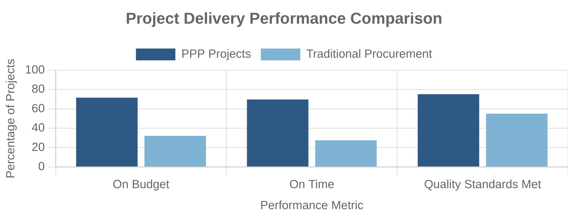
PPP Performance and Value for Money
Cost Comparisons
Long-term Value Assessment
Cost Performance
Value for Money
PPPs generally show better on-time and on-budget performance during construction compared to traditional procurement. However, higher financing costs and transaction expenses can offset these efficiency gains if not managed properly.
Value for Money (VfM) assessment compares whole-life costs of PPP versus traditional procurement, considering risk transfer, financing costs, and efficiency gains. Results vary by sector, project type, and implementation quality.
Performance Factors
Factor
Positive Impact
Negative Impact
Competition
Multiple qualified bidders
Limited market interest
Risk Allocation
Optimal risk transfer
Inappropriate risk allocation
Contract Design
Clear performance metrics
Ambiguous requirements
Governance
Strong contract management
Weak monitoring capacity
Service Quality and Innovation
Market Conditions
Stable financing environment
Financial market volatility
Quality Outcomes
Value for Money Assessment Methodology
Evidence on service quality is mixed, with performance-based payment mechanisms generally driving better maintenance and operational standards. Innovation outcomes depend on output-based specifications and competitive procurement processes.
VfM assessment typically compares the risk-adjusted Public Sector Comparator (PSC) with the PPP alternative. Key components include:
Base costs of traditional procurement
Risk valuation and adjustment
Competitive neutrality adjustments
Discount rate selection
Qualitative factors beyond financial comparison

Slide 30

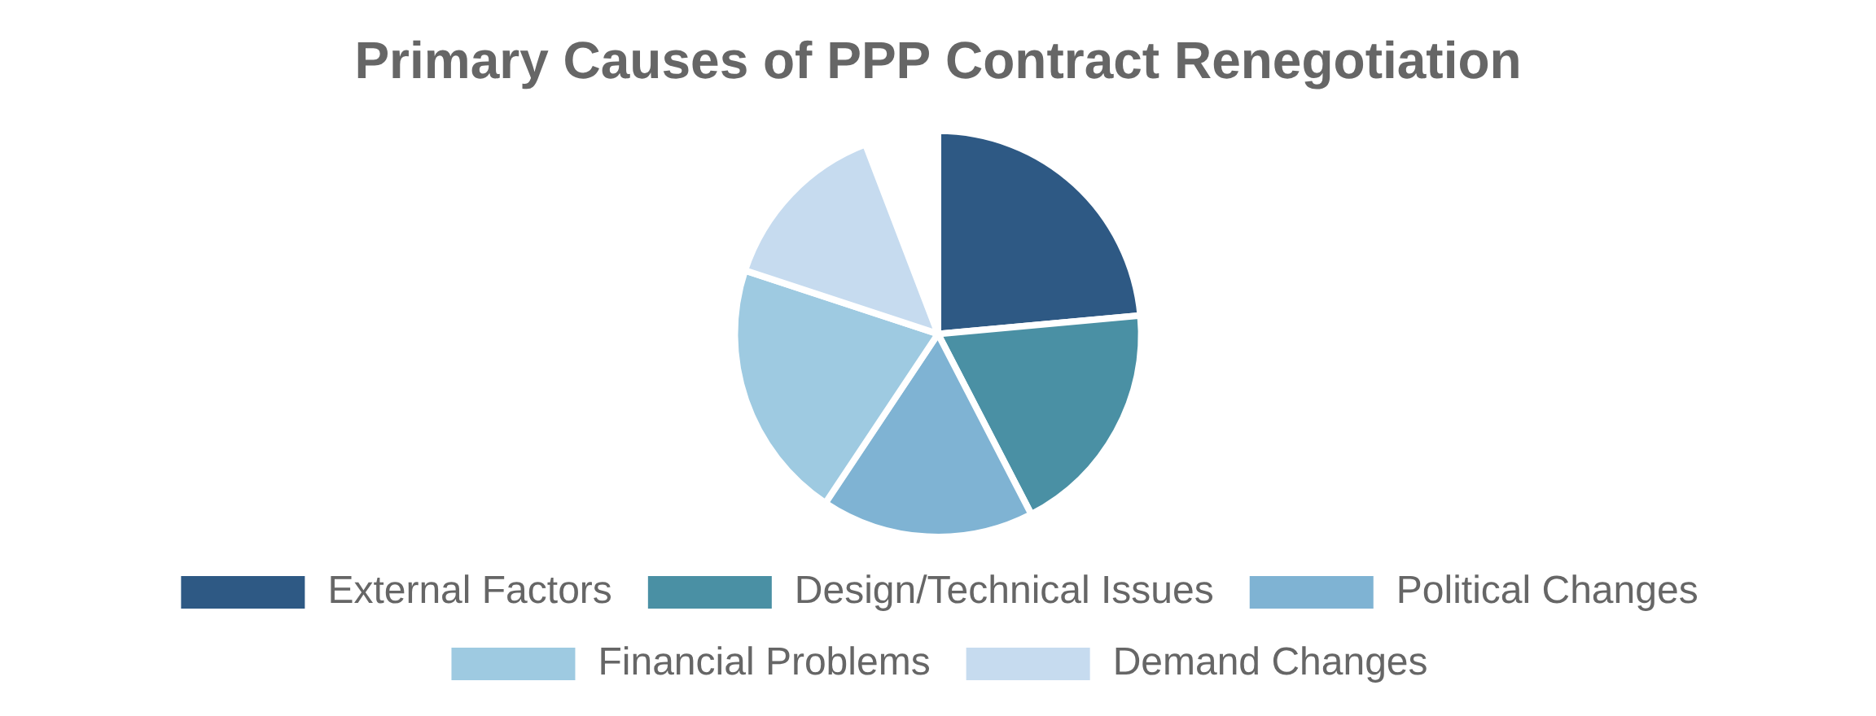
PPP Challenges and Limitations
High Transaction Costs
Political and Public Acceptance
Transaction Complexity
Public Perception
PPPs involve significant transaction costs for both public and private partners, including advisory fees, bid preparation, due diligence, and contract negotiation. These costs can undermine value for money, particularly for smaller projects.
PPPs often face political opposition and public skepticism, particularly regarding user fees, profit motives, and transparency. Successful implementation requires stakeholder engagement, clear communication of benefits, and transparent governance.
Contract Renegotiation Issues
Mitigation Strategies
Challenge
Mitigation Approach
Renegotiation Dynamics
Long-term PPP contracts frequently require renegotiation due to changing circumstances, creating potential for opportunistic behavior. Studies show 40-75% of PPPs are renegotiated, often resulting in increased costs to the public sector.
Transaction Costs
Standardized contracts, bundling similar projects, streamlined procurement
Renegotiation
Flexible contract provisions, independent regulators, transparent processes
Fiscal Illusions
Comprehensive accounting standards, long-term fiscal planning
Public Opposition
Early stakeholder engagement, transparent governance, benefit sharing
Capacity Constraints
Institutional development, training programs, knowledge sharing
Evolution of PPP Models
PPP approaches continue to evolve in response to identified challenges:
More balanced risk allocation frameworks
Greater emphasis on partnership rather than rigid contracts
Hybrid models combining public and private financing
Enhanced transparency and stakeholder participation
Integration with broader infrastructure planning

Slide 31

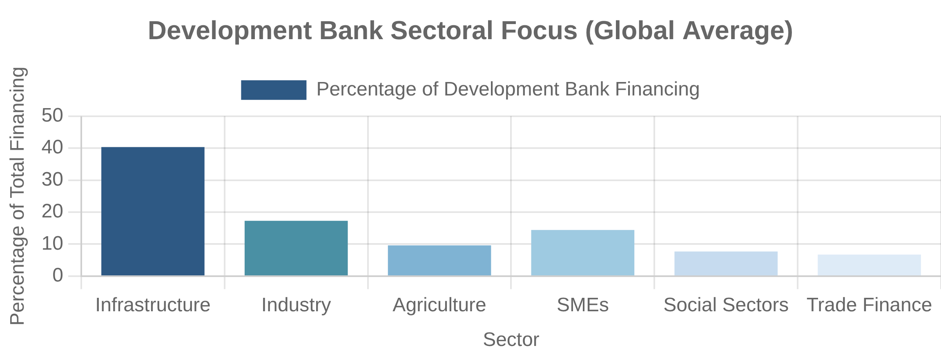
Role of Development Banks
Market Failure Correction
Counter-cyclical Lending
Addressing Market Gaps
Economic Stabilization
Development banks provide financing where private markets are unwilling or unable to do so due to high risk, long tenors, or information asymmetries. They focus on sectors with positive externalities and public goods characteristics that are underserved by commercial finance.
Development banks increase lending during economic downturns when private capital retreats, helping to stabilize investment and maintain critical projects. This counter-cyclical role was particularly evident during the 2008-2009 global financial crisis and the COVID-19 pandemic.
Long-term Development Financing
Key Functions Comparison
Function
National DBs
Multilateral DBs
Patient Capital
Development banks provide long-term financing aligned with infrastructure and industrial development timeframes. Their patient capital supports projects with extended payback periods but significant development impact, enabling structural transformation and economic diversification.
Domestic Infrastructure
Primary focus
Secondary focus
Industrial Policy
Often central
Limited role
SME Support
Major function
Via intermediaries
Policy Advice
Limited scope
Major function
Cross-border Projects
Limited role
Primary focus
Development Bank Definition
Development banks are specialized financial institutions with a mandate to promote economic and social development through:
Providing medium to long-term capital
Supporting underserved sectors and borrowers
Balancing financial sustainability with development impact
Operating with explicit or implicit government backing
Implementing public policy objectives alongside commercial principles

Slide 32

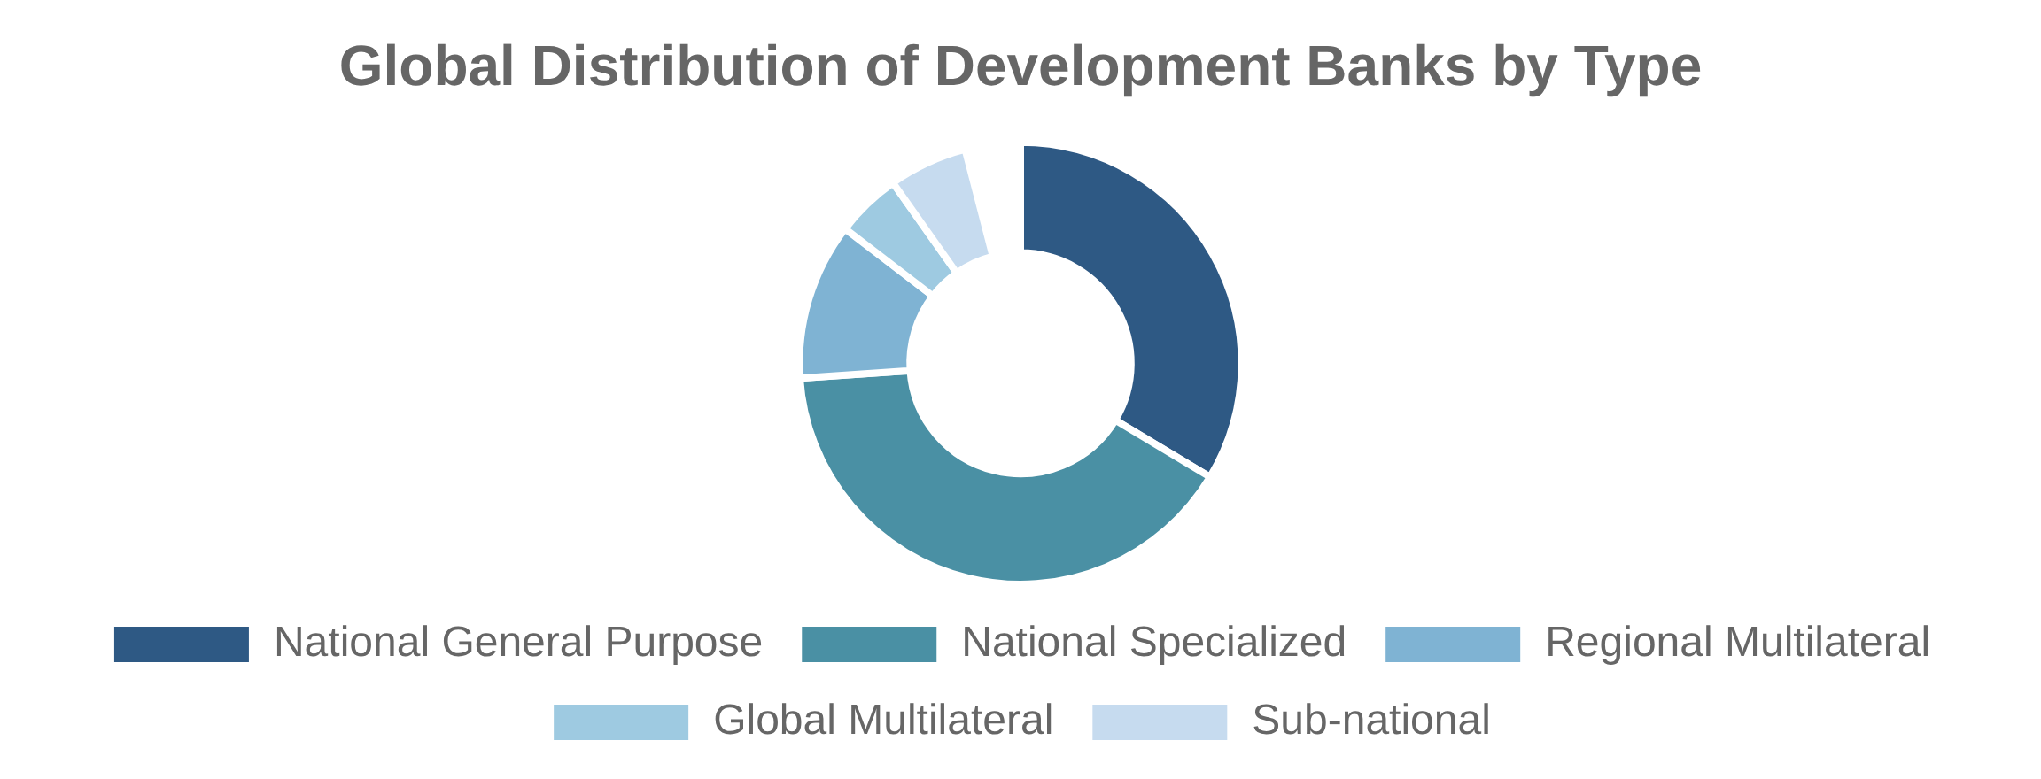
Development Bank Models
National vs. Multilateral Institutions
First-tier vs. Second-tier Operations
Ownership Structure
Operational Approach
National development banks are owned by a single government and focus primarily on domestic development priorities. Multilateral development banks are owned by multiple countries and typically have broader regional or global mandates, with more diverse governance structures.
First-tier development banks lend directly to end borrowers, maintaining close relationships with clients but requiring extensive branch networks. Second-tier institutions work through financial intermediaries, achieving greater scale and market reach while building local financial capacity.
Sectoral vs. General Purpose Banks
Development Bank Typology
Type
Examples
Key Characteristics
Sectoral Focus
General purpose development banks have broad mandates covering multiple sectors. Specialized institutions focus on specific sectors such as agriculture, housing, export-import, or infrastructure, with tailored expertise, instruments, and risk assessment methodologies.
National General Purpose
KfW (Germany), BNDES (Brazil)
Broad mandate, multiple sectors
National Specialized
Banobras (Mexico), EXIM (US)
Sector-specific focus and expertise
Regional Multilateral
ADB, AfDB, IADB
Regional focus, multiple shareholders
Global Multilateral
World Bank Group, IFC
Global mandate, diverse membership
Sub-national
North Rhine-Westphalia Bank
State/provincial ownership and focus
Governance Models
Development bank effectiveness depends on governance arrangements that balance:
Political direction with operational independence
Development mandate with financial sustainability
Public policy objectives with commercial discipline
Risk-taking with prudent management
Accountability with operational flexibility

Slide 33

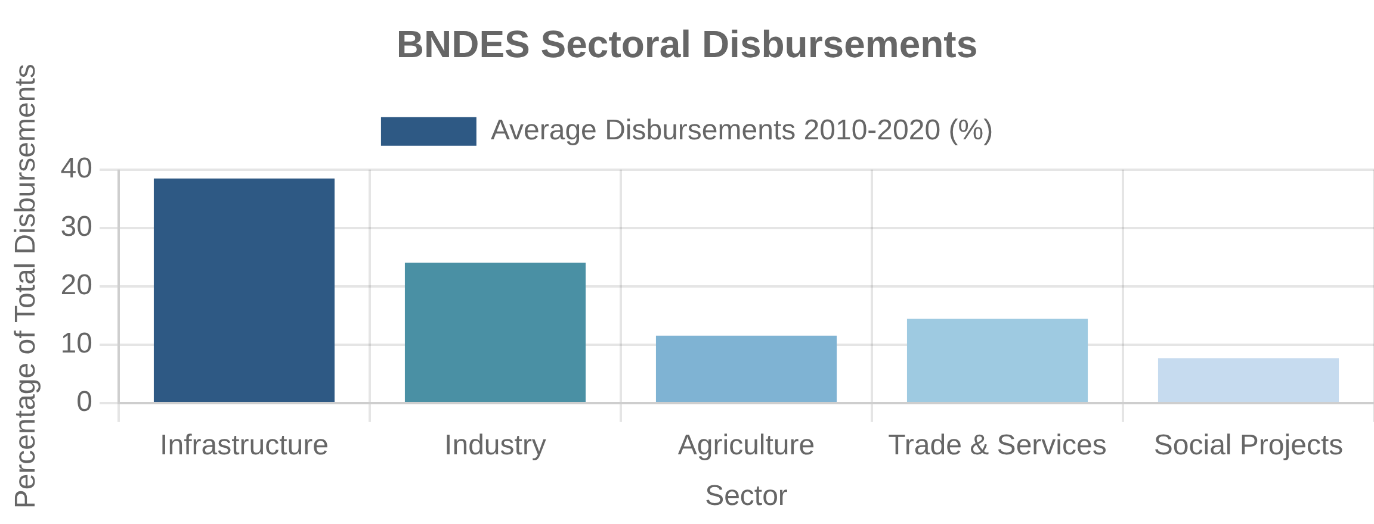
Brazilian Development Bank (BNDES)
History and Evolution
Economic Impact and Controversies
Institutional Development
Development Outcomes
Founded in 1952 as the National Bank for Economic Development (BNDE), later adding "Social" to become BNDES. Initially focused on infrastructure and basic industries, it evolved to support broader industrial policy, privatization programs, and more recently, innovation and sustainability.
Research shows positive impacts on firm investment, employment, and exports. However, evidence on productivity and innovation effects is mixed. BNDES has been instrumental in developing Brazil's infrastructure and supporting counter-cyclical investment during crises.
Lending Programs and Sectors
BNDES Evolution Timeline
Financing Activities
1952-1970s
Focus on infrastructure and import substitution industrialization
BNDES provides long-term financing through direct lending, on-lending via financial intermediaries, and equity investments. Key sectors include infrastructure (energy, transportation, logistics), industry (manufacturing, mining), innovation, exports, and SMEs.
1980s
Crisis management and support for export-oriented industries
1990s
Privatization agent and market-oriented reforms
2000s
Renewed industrial policy focus and international expansion
2010s
Counter-cyclical role during crisis, then scaling back
2020s
Refocus on infrastructure, innovation, and sustainability
Key Debates and Controversies
Subsidized interest rates and fiscal impact
Support for "national champions" and market concentration
Crowding out vs. crowding in private investment
Political influence in lending decisions
Balance between development impact and financial returns

Slide 34

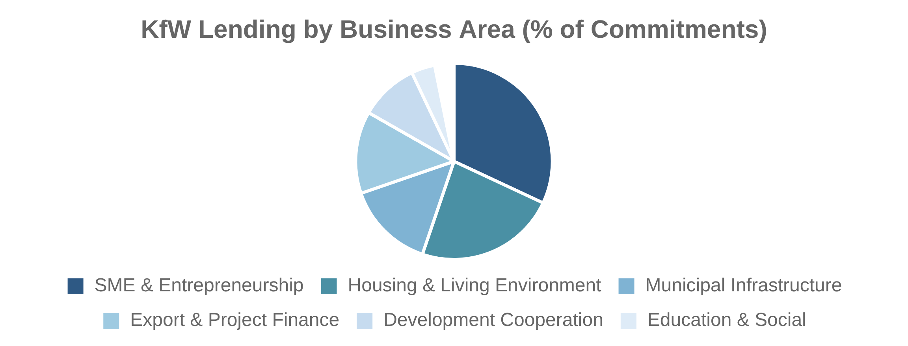
German Development Bank (KfW)
Reconstruction Origins
Environmental and Climate Focus
Post-War Foundation
Green Finance Pioneer
Founded in 1948 as Kreditanstalt für Wiederaufbau (Reconstruction Credit Institute) to administer Marshall Plan funds for Germany's post-war reconstruction. KfW evolved from this specific purpose to become a comprehensive development bank supporting Germany's economic transformation and international development.
KfW has become a global leader in climate and environmental finance, with approximately 40% of new commitments supporting climate action and sustainability. Notable programs include energy-efficient construction, renewable energy financing, and green bonds issuance, making KfW one of the world's largest green bond issuers.
Domestic and International Operations
KfW Group Structure
Dual Mandate
Domestic Business
International Business
KfW Mittelstandsbank (SME Bank)
KfW Development Bank
KfW operates both domestically and internationally through specialized subsidiaries. Domestic focus includes SME finance, housing, infrastructure, and energy efficiency. International activities encompass development finance in emerging economies and export/project finance for German businesses abroad.
KfW Privatkundenbank (Private Client Bank)
DEG (Private Sector Development)
KfW IPEX-Bank (Export and Project Finance)
KfW Kommunalbank (Municipal Bank)
Key International Programs
KfW Capital (Venture Capital)
Climate and environmental protection
Key Domestic Programs
Renewable energy projects
Energy-efficient construction
Financial sector development
SME innovation financing
Infrastructure in developing countries
Municipal infrastructure
Start-up and venture capital
Success Factors
Clear mandate with political consensus
Professional management with operational independence
Strong governance and risk management
Complementary relationship with private banks
Continuous adaptation to changing priorities

Slide 35

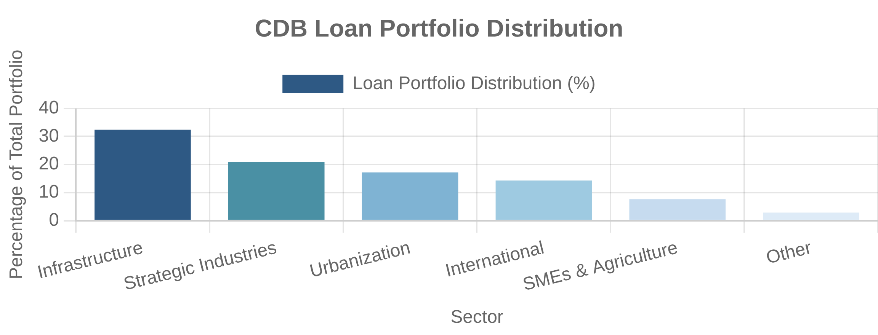
China Development Bank (CDB)
Policy Bank Model
Belt and Road Initiative Role
Strategic Role
Global Expansion
Established in 1994 as one of China's three "policy banks" to separate policy lending from commercial banking. CDB has evolved into the world's largest development finance institution by assets ($2.4 trillion), implementing government priorities while operating on commercial principles with minimal explicit subsidies.
CDB serves as a key financing institution for China's Belt and Road Initiative (BRI), providing over $190 billion in loans for international projects. Its international portfolio focuses on energy, transportation, and industrial parks, often linked to Chinese contractors and equipment suppliers.
Infrastructure and Urbanization Financing
Key Features of CDB Model
Funding Sources
Lending Approach
Domestic Development
Bond issuance (primary source)
Long-term patient capital
Quasi-sovereign credit rating
Catalytic role with local governments
CDB pioneered the "development finance model" using local government financing vehicles (LGFVs) to fund massive urbanization and infrastructure development. This approach enabled rapid infrastructure expansion through land-backed financing, supporting China's economic transformation despite fiscal constraints.
Access to low-cost funding
Package deals with policy support
Limited direct budget support
Whole-of-government coordination
Governance
Risk Management
Direct State Council oversight
Land-based collateral domestically
Strong political backing
Resource-backed loans internationally
Professional management
Policy-commercial hybrid model
Strong recovery mechanisms
Low non-performing loan ratio
The "Development Finance" Model
CDB's distinctive approach combines:
Market-based funding with policy objectives
Long-term planning with commercial discipline
Catalytic role in mobilizing resources
Integration with government development strategies
Comprehensive financial services beyond lending

Slide 36
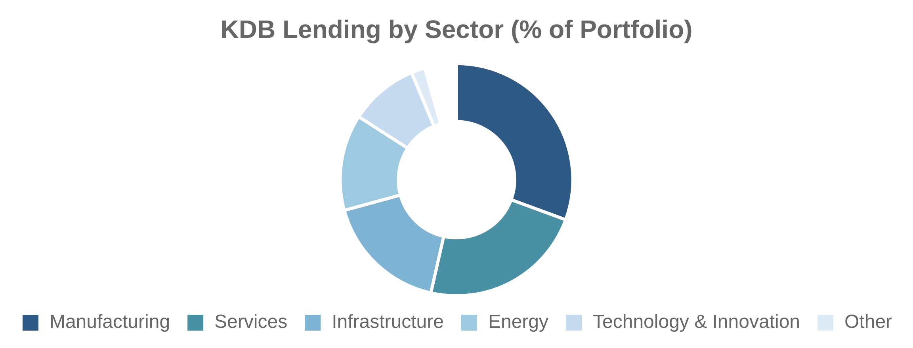
Korean Development Bank (KDB)
Industrial Development Focus
Technology and Innovation Support
Developmental Role
New Growth Engines
Established in 1954 to rebuild Korea's war-torn economy, KDB became a key instrument of Korea's industrial policy. It provided long-term financing for priority sectors under government-led development plans, supporting Korea's transformation from an agricultural to an advanced industrial economy.
In recent decades, KDB has shifted focus toward supporting innovation and technology-intensive industries. It provides venture capital, growth financing, and advisory services for emerging sectors, while maintaining support for traditional industries undergoing technological transformation.
Corporate Restructuring Role
KDB Evolution Timeline
Crisis Management
1950s-1970s
Basic industry and infrastructure development
KDB has played a central role in corporate restructuring during economic crises, particularly after the 1997 Asian Financial Crisis and 2008 Global Financial Crisis. It has managed workout programs for distressed companies, provided liquidity support, and facilitated industry consolidation and reorganization.
1980s
Heavy and chemical industry promotion
1990s
Globalization and financial crisis response
2000s
Restructuring and attempted privatization
2010s
Innovation focus and global expansion
2020s
Green growth and digital transformation
Key Lessons from KDB Model
Effective alignment with national industrial policy
Flexibility to adapt to changing economic needs
Balance between policy mandates and financial sustainability
Importance of professional expertise and capacity
Risks of excessive corporate debt and moral hazard

Slide 37

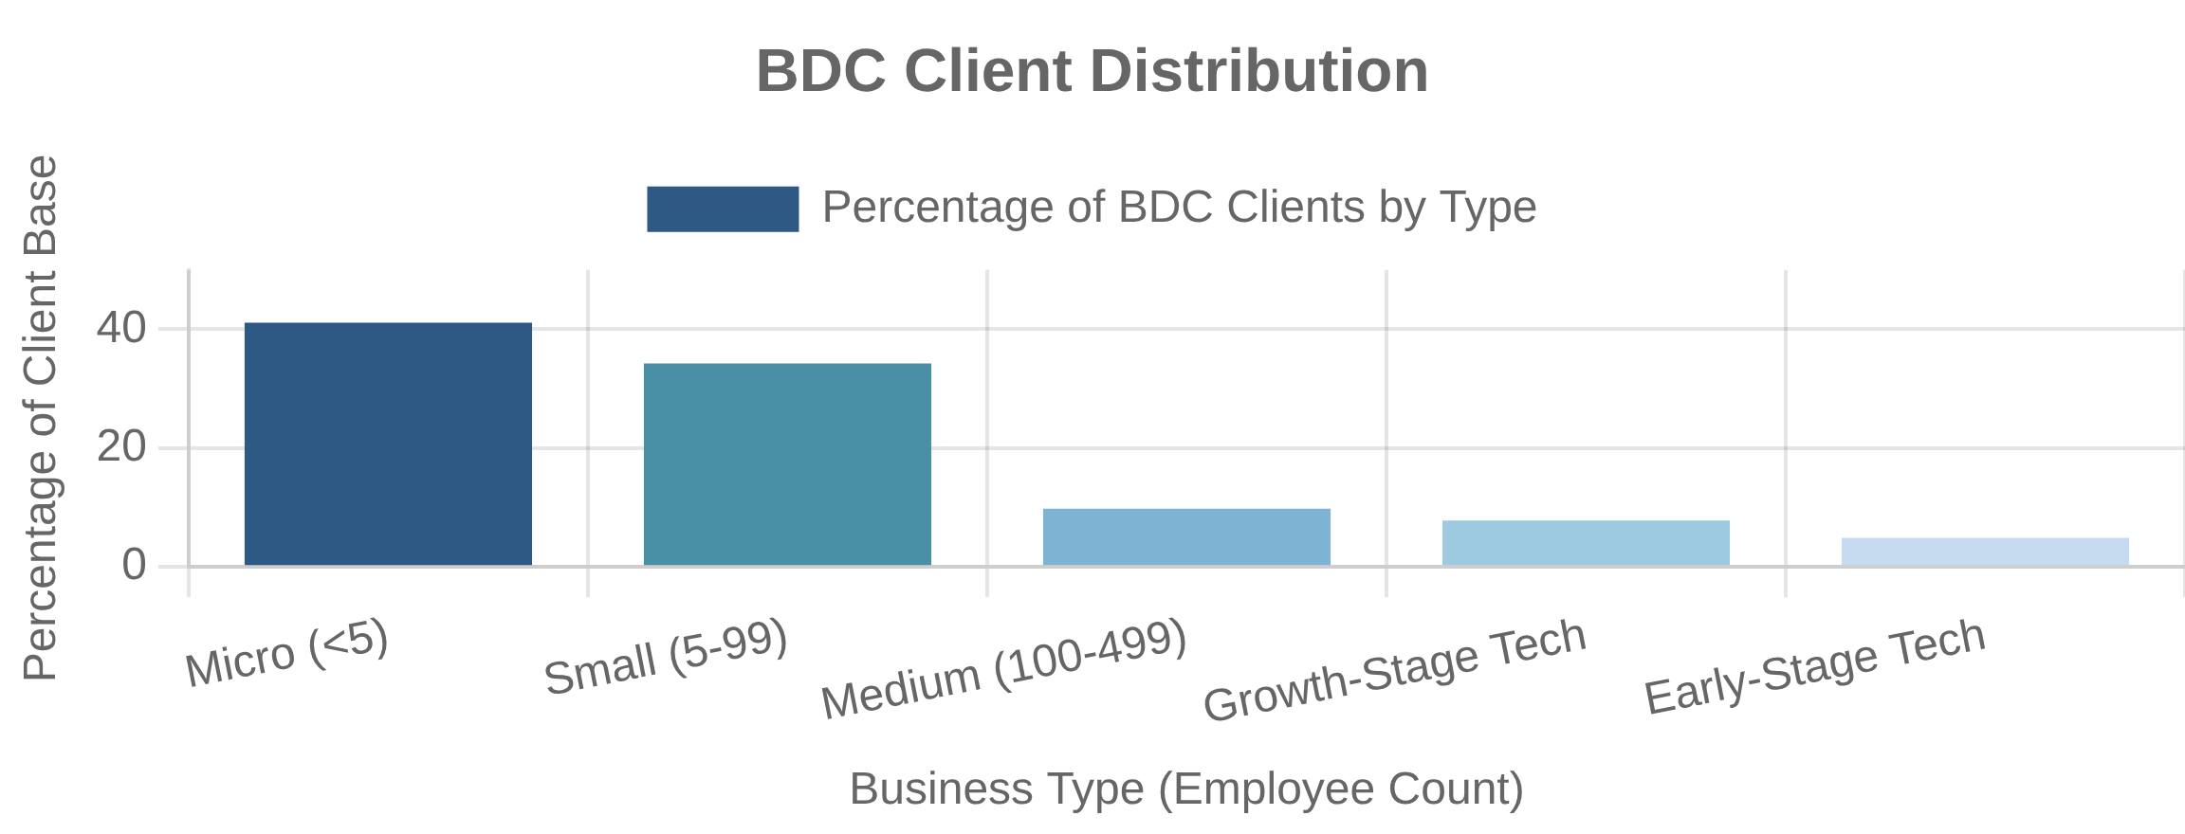
Business Development Bank of Canada (BDC)
SME Financing Focus
Regional Development Mandate
Small Business Support
Geographic Inclusion
BDC is Canada's bank for entrepreneurs, focusing exclusively on small and medium-sized enterprises (SMEs). Unlike many development banks that prioritize large infrastructure or industrial projects, BDC specializes in addressing the financing gaps faced by smaller businesses, particularly at critical growth stages.
BDC maintains a nationwide presence with over 100 business centers across Canada, ensuring access to financing and advisory services in underserved regions. The bank has specific programs targeting rural areas, Indigenous entrepreneurs, and economically disadvantaged communities, supporting more balanced regional development.
Venture Capital and Growth Capital
BDC Financial Products and Services
Innovation Ecosystem
Financing Solutions
Advisory Services
Term loans with flexible conditions
Business strategy consulting
BDC Capital, the bank's investment arm, is Canada's largest early-stage technology investor. It provides venture capital, growth equity, and intellectual property financing to innovative firms. BDC plays a catalytic role in developing Canada's venture capital ecosystem, both through direct investments and fund-of-funds activities.
Working capital financing
Operational efficiency
Equipment purchase financing
Digital transformation
Technology financing
Financial management
Commercial real estate financing
International expansion
Investment Products
Special Programs
Seed and early-stage venture capital
Indigenous entrepreneur support
Growth equity investments
Women entrepreneur accelerator
Women in Technology Venture Fund
Cleantech practice
Intellectual property financing
COVID-19 relief programs
Fund investments (fund-of-funds)
Supply chain financing
BDC's Complementary Approach
Market complementarity rather than substitution
Focus on underserved segments and market gaps
Financial sustainability without ongoing subsidies
Combination of financial and advisory services
Counter-cyclical role during economic downturns

Slide 38
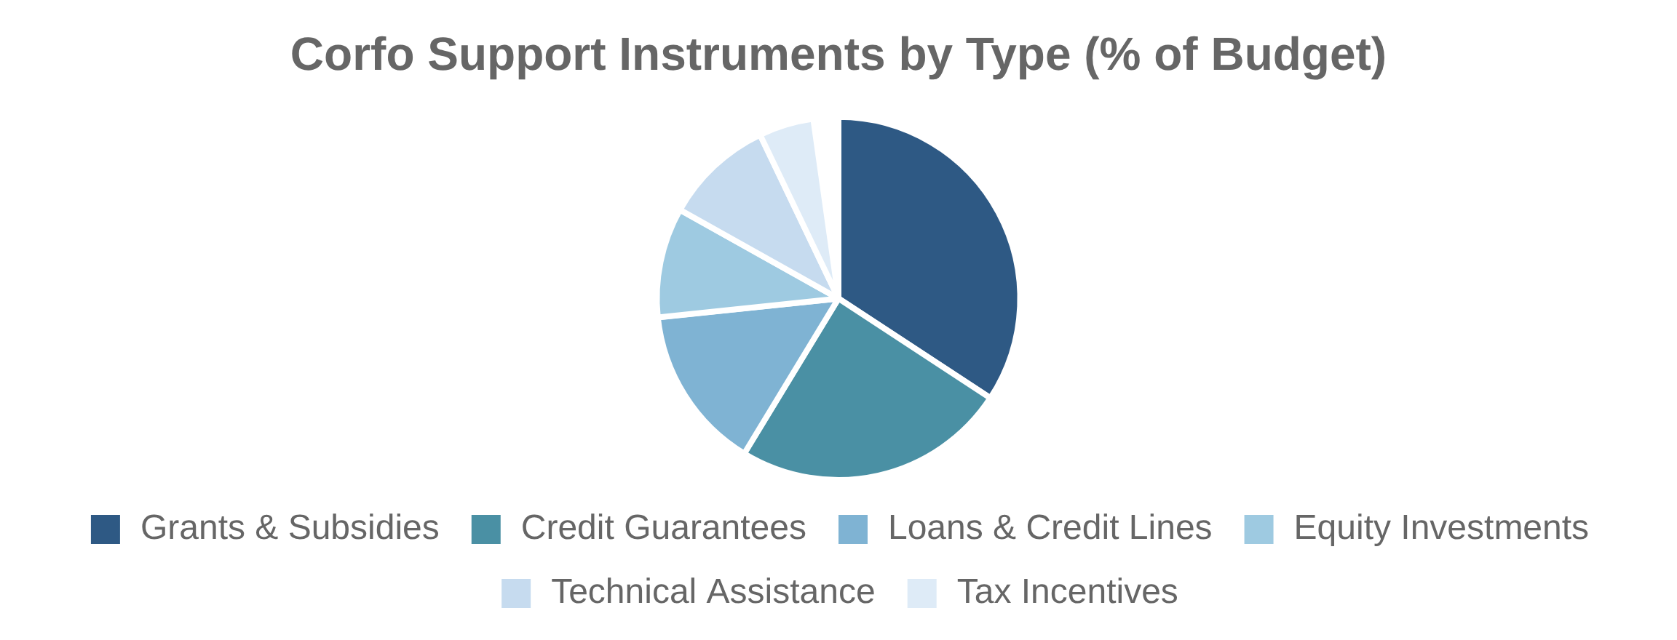
Chilean Development Agency (Corfo)
Supplier Development Programs
Public-Private Collaboration
Value Chain Integration
Strategic Programs
Corfo's Supplier Development Program (PDP) strengthens linkages between large firms and their SME suppliers. The program co-finances technical assistance, training, and certification to help local suppliers meet quality standards and specifications of large "anchor" companies, creating more integrated and competitive value chains.
Corfo implements strategic programs that bring together government, industry, academia, and civil society to develop specific sectors with high growth potential. These collaborative initiatives include Smart Specialization Strategies, technology consortia, and cluster development programs that address coordination failures and promote collective action.
Innovation and Entrepreneurship
Key Corfo Programs and Instruments
Startup Ecosystem
Financing Instruments
Business Development
Credit guarantees (FOGAIN)
Supplier Development Program
Corfo has developed a comprehensive innovation support system including Start-Up Chile (a pioneering accelerator program), seed and venture capital funds, R&D tax incentives, and technology transfer offices. These programs have transformed Chile's entrepreneurial ecosystem, making it a leading innovation hub in Latin America.
Long-term investment credit lines
Associative Development Projects
Early-stage equity funds (SSAF)
SME digitalization support
Venture capital fund-of-funds
Export promotion programs
Green financing instruments
Management skills development
Innovation Support
Strategic Initiatives
Start-Up Chile accelerator
Smart Specialization Strategies
R&D tax incentives
Solar energy program (solar desert)
Technology transfer offices
Mining suppliers program
Innovation vouchers
Food industry innovation
Prototyping subsidies
Digital transformation
Corfo's Institutional Evolution
1939: Founded to lead industrialization and reconstruction
1970s-80s: Privatization and market-oriented reforms
1990s: Refocus on SMEs and competitiveness
2000s: Emphasis on innovation and entrepreneurship
2010s-present: Strategic sectors and collaborative governance

Slide 39

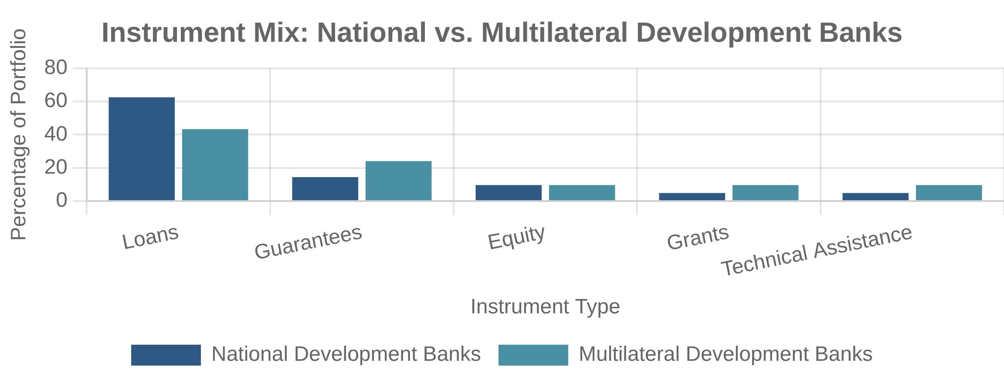
Development Bank Tools and Instruments
Loans and Credit Lines
Guarantees and Risk Mitigation
Debt Financing
Risk Sharing
Direct loans remain the core instrument of most development banks, with distinctive features including longer tenors (10-30 years), grace periods, fixed or subsidized interest rates, and local currency options. Development banks also provide credit lines to financial intermediaries for on-lending to specific sectors or borrower types.
Guarantees enable development banks to leverage their capital by sharing risk rather than providing direct funding. These include partial credit guarantees (covering a portion of loan defaults), political risk guarantees (protecting against non-commercial risks), and portfolio guarantees (covering pools of loans to specific sectors).
Equity Investments and Funds
Instrument Comparison
Instrument
Advantages
Limitations
Ownership Stakes
Many development banks make equity investments, either directly in companies or through specialized subsidiaries. Fund-of-funds approaches, where development banks invest in private equity or venture capital funds, have become increasingly common to leverage private capital and develop local investment ecosystems.
Direct Loans
Full control over terms and conditions
High administrative costs, limited reach
Credit Lines
Greater scale and reach through intermediaries
Less control over final lending decisions
Equity Investments
Higher returns potential, governance influence
Higher risk, exit challenges, capacity requirements
Guarantees
Capital efficiency, private sector mobilization
Contingent liability management, moral hazard
Technical Assistance
Addresses non-financial constraints
Resource intensive, impact measurement challenges
Innovative Financial Instruments
Blended finance structures combining concessional and commercial capital
Results-based financing with payments linked to outcomes
Green bonds and sustainability-linked loans
Local currency financing solutions
Digital platforms for SME lending and supply chain finance

Slide 40

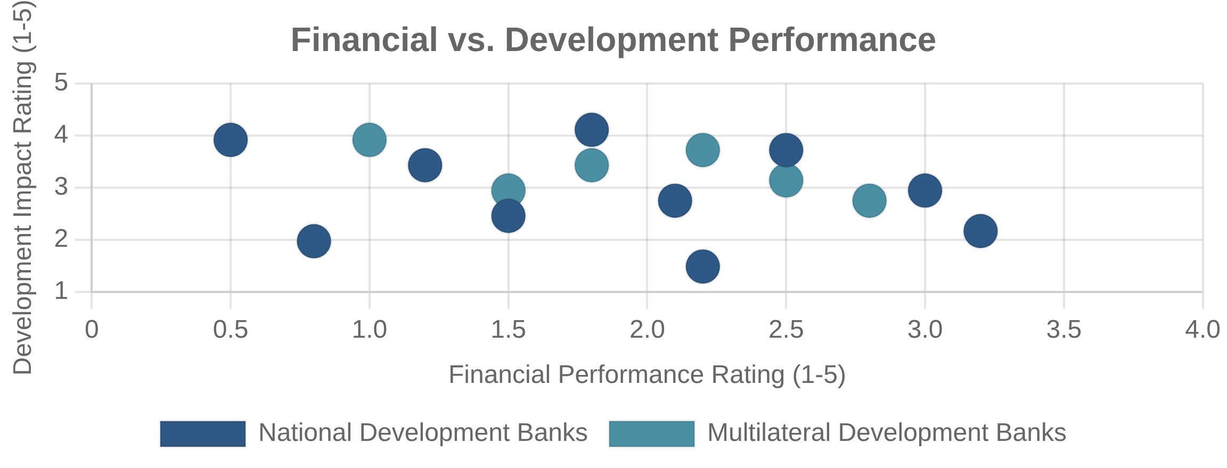
Development Bank Performance
Financial Sustainability
Additionality and Market Effects
Balancing Act
Value Addition
Development banks must balance financial sustainability with development mandates. While most aim to be self-sustaining rather than profit-maximizing, they need to maintain adequate returns to preserve capital, cover operating costs, and attract co-financing. Performance varies widely, with some banks requiring regular recapitalization while others maintain strong financial positions.
A key performance criterion for development banks is "additionality" – the value they add beyond what private markets would provide. This includes financial additionality (providing financing unavailable from commercial sources) and non-financial additionality (improving project design, governance, or environmental/social standards). Demonstrating additionality is increasingly important for legitimacy.
Development Impact Measurement
Key Performance Metrics
Beyond Financial Returns
Financial Metrics
Development Metrics
Return on assets (ROA)
Jobs created or supported
Development banks increasingly employ sophisticated frameworks to measure their development impact, moving beyond output metrics (e.g., loans disbursed) to outcomes and impacts. These include results frameworks with indicators aligned to SDGs, theory of change models, impact rating systems, and independent evaluations to assess contribution to development objectives.
Return on equity (ROE)
GHG emissions reduced
Non-performing loan ratio
Infrastructure access expanded
Capital adequacy ratio
SME growth and formalization
Administrative efficiency ratio
Contribution to SDG targets
Mobilization Metrics
Governance Metrics
Private capital mobilization ratio
Transparency and disclosure
Co-financing percentage
Environmental and social safeguards
Catalyzation multiplier
Anti-corruption measures
Market development indicators
Stakeholder engagement
Demonstration effects
Accountability mechanisms
Performance Measurement Challenges
Attribution of development outcomes to specific interventions
Long time horizons for impact realization
Trade-offs between different performance dimensions
Data limitations in developing country contexts
Balancing standardization with context-specificity

Slide 41

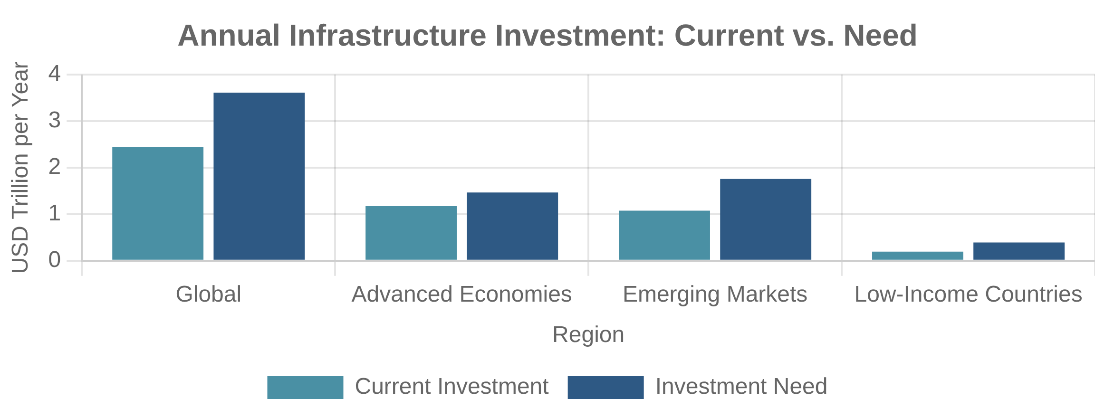
Infrastructure Investment Needs
Global Infrastructure Gaps
Climate and Digital Infrastructure
Massive Investment Requirements
New Imperatives
Global infrastructure investment needs are estimated at $94 trillion through 2040 (Global Infrastructure Hub), or approximately $3.7 trillion annually. Current investment levels average only $2.5-3.0 trillion per year, creating an annual funding gap of $0.7-1.2 trillion. This gap represents both maintenance of existing assets and new infrastructure to support growth.
Beyond traditional infrastructure, massive investments are needed in climate-resilient and digital infrastructure. Climate adaptation requires $140-300 billion annually by 2030, while clean energy transition needs $3-5 trillion annually. Digital infrastructure demands $0.5-1.0 trillion yearly for broadband, data centers, and smart systems to support the digital economy.
Developing Country Requirements
Sectoral Investment Needs (2020-2040)
Development Imperatives
Transportation
Water & Sanitation
Roads: $18 trillion
Water supply: $7 trillion
Emerging markets and developing economies face particularly acute infrastructure challenges, requiring $1.5-2.0 trillion annually to meet development goals. These countries must simultaneously build basic infrastructure (water, sanitation, electricity), expand transportation networks, and invest in digital connectivity, often with limited fiscal space and institutional capacity.
Railways: $7 trillion
Sanitation: $4 trillion
Ports: $2 trillion
Irrigation: $1 trillion
Airports: $1 trillion
Flood protection: $2 trillion
Urban transit: $5 trillion
Water resource management: $1 trillion
Energy
Power generation: $10 trillion
Digital & Social
Transmission & distribution: $6 trillion
Telecommunications: $6 trillion
Renewable energy: $8 trillion
Data infrastructure: $2 trillion
Energy storage: $2 trillion
Healthcare facilities: $3 trillion
Energy efficiency: $3 trillion
Educational facilities: $2 trillion
Affordable housing: $4 trillion
The Infrastructure Financing Gap
Public budgets can only cover 40-50% of infrastructure needs
Private investment currently provides only 20-25% of total
MDBs and development finance contribute 5-10%
Remaining 15-35% represents the "financing gap"
Gap is largest in low-income and lower-middle-income countries

Slide 42
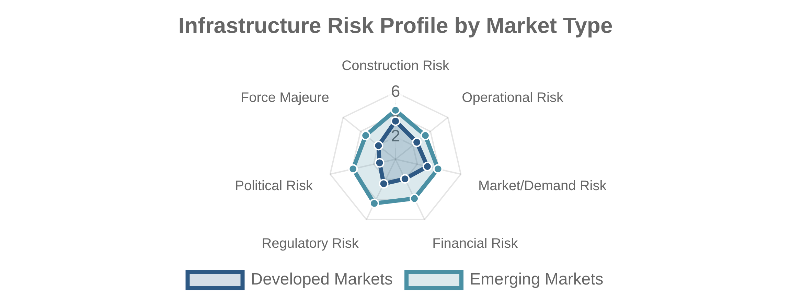
Infrastructure Financing Challenges
Long-Term Capital Requirements
Market Failures in Infrastructure
Maturity Mismatch
Structural Challenges
Infrastructure projects typically require long-term financing (15-30+ years) to match asset lifecycles and revenue streams. However, most financial markets are dominated by shorter-term capital (3-7 years). This maturity mismatch creates refinancing risks and higher costs, particularly in developing countries with underdeveloped long-term debt markets.
Infrastructure markets suffer from inherent market failures: natural monopoly characteristics in many sectors, significant positive and negative externalities not captured in pricing, public good aspects of some infrastructure, and information asymmetries between project sponsors and financiers. These failures limit pure market-based solutions.
Risk Characteristics
Key Barriers to Infrastructure Investment
Complex Risk Profile
Public Sector Barriers
Project-Level Barriers
Fiscal constraints and debt limits
Inadequate feasibility studies
Infrastructure investments involve multiple risk layers: construction risks (delays, cost overruns), operational risks (maintenance, technology), market risks (demand, pricing), and political/regulatory risks (policy changes, expropriation). These risks evolve over project lifecycles and require sophisticated allocation mechanisms that many markets lack.
Weak project preparation capacity
Poor risk allocation frameworks
Regulatory uncertainty
Weak governance structures
Political interference in projects
Environmental/social complications
Inadequate pricing policies
Insufficient revenue models
Financial Market Barriers
Institutional Barriers
Limited long-term financing
Fragmented government authority
Underdeveloped project finance
Limited technical expertise
Currency mismatch issues
Procurement inefficiencies
Restrictive investment regulations
Corruption and transparency issues
Lack of standardized instruments
Weak contract enforcement
Addressing Financing Challenges
Developing specialized infrastructure financing vehicles
Enhancing risk mitigation and credit enhancement tools
Strengthening project preparation and governance
Mobilizing institutional investor capital
Creating enabling policy and regulatory environments

Slide 43

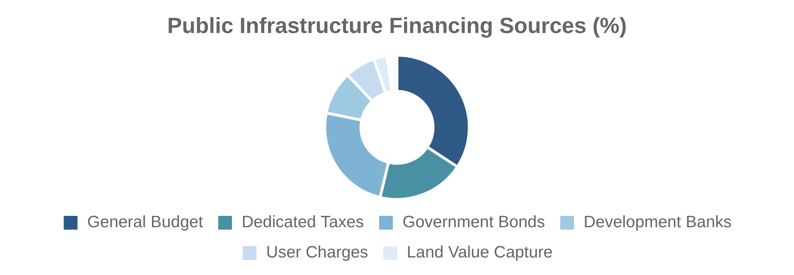
Public Infrastructure Financing
Government Budgets and Debt
Special Purpose Vehicles
Traditional Approach
Off-Balance Sheet Structures
Direct government financing remains the dominant source of infrastructure funding globally (50-70% of total). This includes budget allocations from general tax revenues, dedicated infrastructure funds, and sovereign borrowing.
Governments increasingly use special purpose vehicles (SPVs) to finance infrastructure while managing fiscal constraints. These include state infrastructure banks, national infrastructure funds, and project-specific entities.
Infrastructure Bonds
Public Financing Models by Country
Debt Instruments
Advanced Economies
Latin America
US: Municipal bond market ($3.9T)
Brazil: BNDES development bank
Governments increasingly use specialized bonds for infrastructure financing: general obligation bonds backed by government credit, revenue bonds secured by project income streams, green bonds for environmental projects, and municipal bonds issued by local governments.
Japan: FILP government bank system
Mexico: FONADIN infrastructure fund
Chile: Concession-based approach
Germany: KfW on-lending model
Africa & Middle East
Emerging Asia
South Africa: DBSA development bank
China: Policy bank financing
India: National Infrastructure Pipeline
Morocco: Strategic infrastructure funds
Indonesia: SOE-led development
UAE: Sovereign wealth fund investments
Emerging Trends in Public Financing
Dedicated infrastructure taxes and user charges
Land value capture mechanisms
Sovereign green bonds for climate-resilient infrastructure
Asset recycling through privatization of mature assets

Slide 44

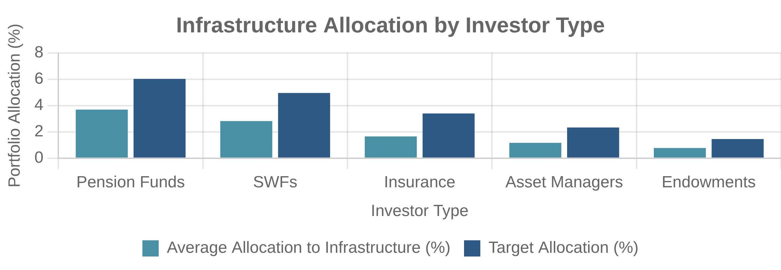
Private Infrastructure Financing
Infrastructure Funds and Investors
Infrastructure as Asset Class
Specialized Investment Vehicles
Distinctive Investment Characteristics
Private infrastructure funds have grown significantly, with over $800 billion in assets under management globally. These include closed-end private equity-style funds (typically 10-12 year terms), open-ended funds with longer horizons, and listed infrastructure funds traded on public markets. These vehicles provide institutional investors with access to diversified infrastructure portfolios.
Infrastructure has emerged as a distinct asset class with specific characteristics: long-term stable cash flows, inflation protection, low correlation with other assets, monopolistic market positions, and regulatory/contractual protections. Returns typically range from 8-12% for core infrastructure to 15%+ for opportunistic investments, with risk profiles between fixed income and private equity.
Pension Fund Involvement
Major Private Infrastructure Investors
Long-Term Institutional Capital
Pension Funds
Infrastructure Fund Managers
CPPIB (Canada): $40B+ allocation
Macquarie: $150B+ AUM
Pension funds, with over $50 trillion in global assets, are increasingly allocating capital to infrastructure (typically 1-5% of portfolios). Leading Canadian pension funds (CPPIB, OTPP) pioneered direct infrastructure investment, while others invest through funds. Infrastructure's long-term, inflation-linked cash flows match pension liabilities, though regulatory constraints and expertise gaps limit greater allocation.
APG (Netherlands): $25B+ allocation
Brookfield: $120B+ AUM
QIC (Australia): $15B+ allocation
Global Infrastructure Partners: $75B+ AUM
Sovereign Wealth Funds
GIC (Singapore): $25B+ allocation
Insurance Companies
ADIA (UAE): $45B+ allocation
Allianz: $15B+ allocation
PIF (Saudi Arabia): $40B+ allocation
AXA: $10B+ allocation
Swiss Re: $5B+ allocation
Barriers to Private Investment
Regulatory uncertainty and political risk
Limited pipeline of bankable projects
Lack of standardized performance data
Liquidity constraints and high transaction costs

Slide 45
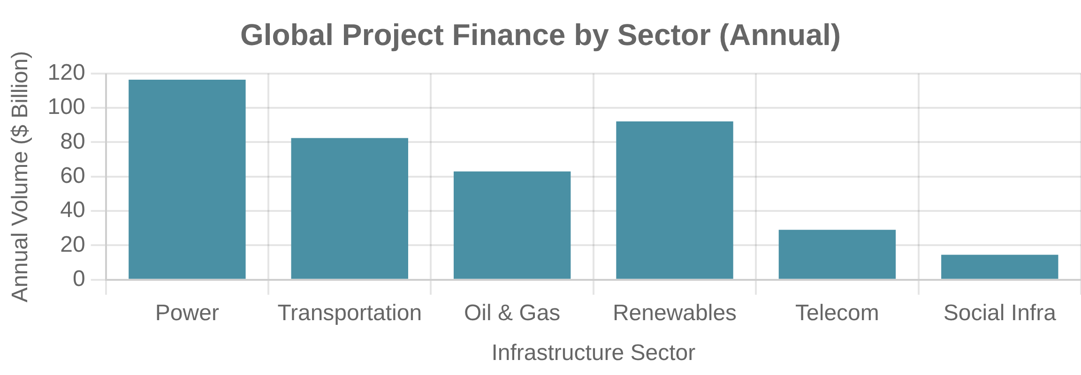
Project Finance for Infrastructure
Non-Recourse Financing Structures
International Project Finance
Project Finance Fundamentals
Cross-Border Considerations
Project finance is a specialized financing technique where lenders rely primarily on project cash flows for repayment, with limited or no recourse to sponsors. This approach involves creating a standalone Special Purpose Vehicle (SPV) with dedicated assets, contracts, and financing. Project finance enables high leverage (70-90% debt), risk isolation, and off-balance-sheet treatment for sponsors.
International project finance adds complexity through currency risk, political risk, and cross-jurisdictional legal issues. Mitigants include currency hedging, political risk insurance from agencies like MIGA, international arbitration provisions, and involvement of multilateral development banks. These projects often use export credit agencies to support equipment imports and provide additional guarantees.
Risk Allocation and Mitigation
Project Finance Structure Components
Risk Management Framework
Key Participants
Financing Instruments
Project sponsors/equity investors
Senior term loans
Effective project finance requires systematic risk allocation to parties best positioned to manage each risk. Key mechanisms include: construction contracts with fixed-price, date-certain terms; long-term offtake agreements securing revenue streams; operation and maintenance agreements with performance guarantees; and insurance packages covering force majeure and other insurable risks.
Senior lenders (banks, bonds)
Project bonds
Mezzanine/subordinated lenders
Subordinated debt
EPC contractors
Equity bridge loans
O&M contractors
VAT/working capital facilities
Contractual Framework
Security Package
Concession/license agreements
Asset pledges/mortgages
Power purchase agreements
Assignment of contracts
Throughput agreements
Cash flow waterfall
Supply contracts
Reserve accounts
Shareholder agreements
Sponsor support agreements
Project Finance Market Trends
Growing role of institutional investors in project debt
Expansion of green/sustainable project finance
Increasing use of hybrid structures (corporate + project finance)
Digital infrastructure emerging as major sector

Slide 46

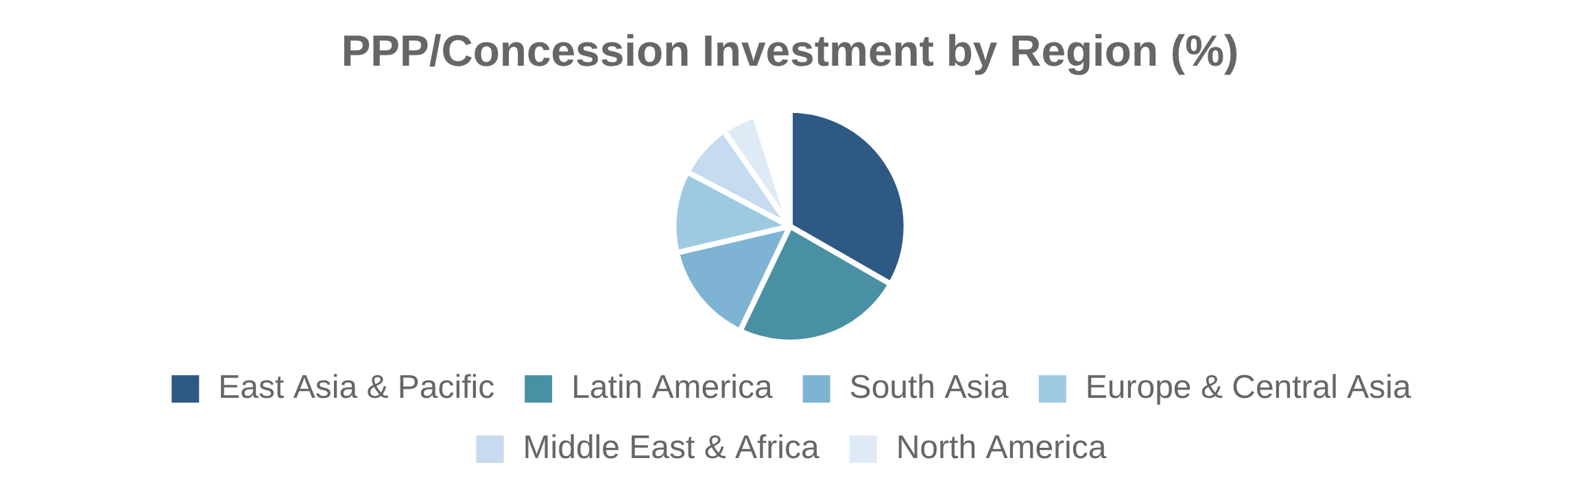
Infrastructure PPPs and Concessions
Transportation Concessions
Social Infrastructure PPPs
Mobility Infrastructure
Public Service Facilities
Transportation represents the largest sector for infrastructure concessions globally. Models include toll roads with direct user charges or availability payments, airports with aeronautical and commercial revenues, and seaports with terminal operations and throughput fees.
Social infrastructure PPPs have expanded beyond traditional economic infrastructure to include hospitals, schools, prisons, government buildings, and affordable housing. These typically use availability payment models where government pays for facility availability and performance.
Utility Privatizations
Notable PPP/Concession Cases
Essential Services
Success Stories
Challenges/Failures
Chile's highway concession program
Mexico's toll road program (1990s)
Utility privatizations and concessions have transformed infrastructure service delivery in many countries. Models range from full privatization (UK water and energy) to long-term concessions (Latin American water) to management contracts (African utilities).
UK's Hospital PPP portfolio
Hungary's M1/M15 highway
Australia's Port of Melbourne lease
UK's Metronet rail PPP
Mixed Results
Emerging Models
India's highway PPP program
Hybrid PPPs with flexible risk sharing
Brazil's airport concessions
Outcome-based infrastructure contracts
UK's London Underground PPP
Climate-resilient PPP frameworks
Key Lessons from Global Experience
Realistic risk allocation is more important than maximum risk transfer
Regulatory certainty and contract stability are essential for success
Transparent procurement and contract management build public trust
Flexibility mechanisms help adapt to changing circumstances

Slide 47

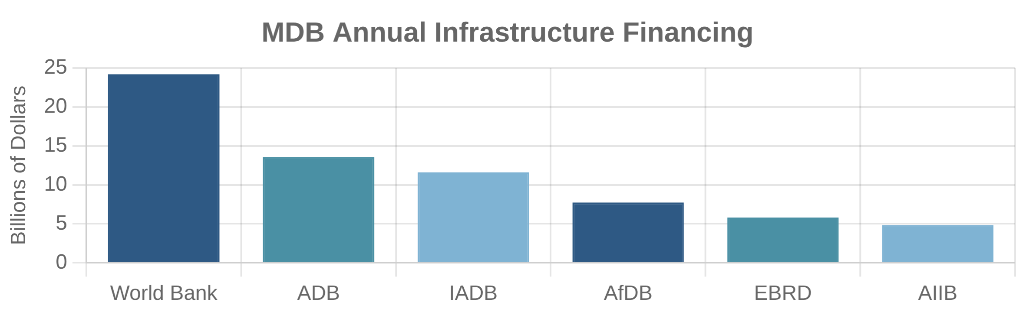
Development Finance for Infrastructure
Multilateral Development Banks
Bilateral Development Finance
World Bank Group
US DFC:
Provides loans, loan guarantees, and political risk insurance with $60 billion portfolio capacity
IBRD, IDA, and IFC provide loans, grants, and equity investments for infrastructure in developing countries, with $47 billion in annual commitments.
Japan's JBIC:
Focuses on energy and transportation infrastructure with emphasis on quality standards
European DFIs:
Regional Development Banks
KfW (Germany), AFD (France), and CDC (UK) coordinate through joint initiatives
ADB, AfDB, IADB, and EBRD focus on regional infrastructure priorities with specialized knowledge of local contexts and needs.
Blended Finance Mechanisms
New Multilateral Institutions
Combining public and private capital to de-risk infrastructure investments. First-loss guarantees, viability gap funding, and technical assistance facilities help mobilize private investment for projects that would otherwise be commercially unviable.
AIIB and NDB (BRICS Bank) represent emerging powers' infrastructure financing initiatives, with $10-15 billion in annual lending.
Development Finance Innovations
Green Bonds:
MDBs issued $80+ billion in green bonds for climate-friendly infrastructure
Local Currency Financing:
Reducing exchange rate risks for infrastructure revenue streams
Project Preparation Facilities:
Addressing early-stage development bottlenecks

Slide 48

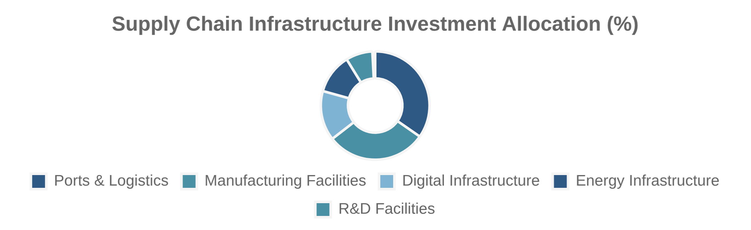
Supply Chain Infrastructure
Critical Supply Chain Infrastructure
Public-Private Collaboration Models
Ports and Maritime Facilities
Industrial Site Preparation:
Government-funded site readiness for strategic manufacturing
Modernization of port infrastructure, automated container handling, and intermodal connections to reduce bottlenecks and increase throughput capacity.
Shared Infrastructure:
Joint development of specialized facilities for multiple users
Technology Testbeds:
Strategic Storage and Distribution
Public facilities for supply chain innovation and piloting
Advanced warehousing, strategic stockpiles for critical materials, and regional distribution centers to enhance resilience against disruptions.
Case Study: Semiconductor Supply Chain
Manufacturing Facilities
The CHIPS Act allocates $39 billion for manufacturing incentives and $11 billion for R&D infrastructure. Public investments in water, power, and transportation infrastructure complement private fab investments, creating manufacturing clusters with shared resources.
Semiconductor fabs, pharmaceutical production, and advanced materials processing facilities to address strategic vulnerabilities.
Financing Approaches
Federal Grants:
Direct funding for critical supply chain infrastructure
Tax Incentives:
Investment tax credits for qualifying facilities
Loan Guarantees:
Risk reduction for private infrastructure financing
State and Local Matching:
Coordinated multi-level government support

Slide 49

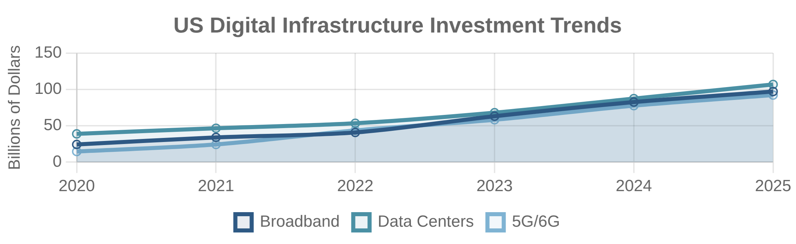
Digital and Energy Infrastructure
Digital Infrastructure
Energy Infrastructure
Broadband Networks
Renewable Generation
Fiber optic backbone, last-mile connectivity, and rural broadband expansion to close the digital divide and enable economic participation.
Utility-scale solar, offshore wind, and geothermal facilities with domestic supply chains and advanced manufacturing.
Data Centers
Energy Storage
Hyperscale facilities, edge computing nodes, and specialized AI infrastructure to support digital economy growth and data sovereignty.
Grid-scale batteries, pumped hydro, and emerging long-duration storage technologies to enable renewable integration and grid resilience.
5G/6G Networks
Smart Grid
Next-generation wireless infrastructure enabling smart cities, autonomous vehicles, and industrial IoT applications with secure supply chains.
Advanced transmission, distribution automation, and grid-edge intelligence to enhance reliability, efficiency, and cybersecurity.
Financing Innovation
Green banks, sustainability-linked bonds, and infrastructure-as-a-service models are emerging to address the unique financing challenges of digital and energy infrastructure, particularly for projects with high upfront costs but long-term benefits.

Slide 50

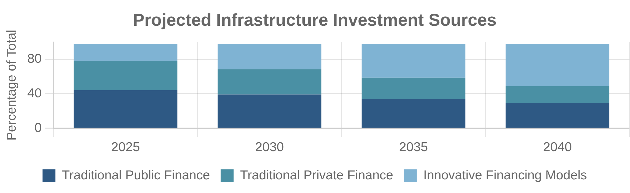
Future of Infrastructure Financing
Emerging Trends
Policy Innovations
Outcome-Based Financing
National Infrastructure Bank:
Dedicated institution with specialized expertise and long-term capital
Linking investment returns to measurable performance metrics and social/environmental outcomes rather than traditional fixed returns.
Regulatory Sandboxes:
Controlled environments for testing innovative financing approaches
Democratized Infrastructure
Standardized ESG Metrics:
Common frameworks for measuring sustainability impacts
Community ownership models, crowdfunding platforms, and retail investment vehicles making infrastructure accessible to smaller investors.
Cross-Border Coordination:
Harmonized approaches for transnational infrastructure
Tokenization and Digital Assets
Blockchain-based infrastructure tokens enabling fractional ownership, increased liquidity, and automated revenue distribution.
Technological Enablers
Digital Twins:
Virtual replicas enabling optimization and risk reduction
AI-Powered Analytics:
Enhanced forecasting of demand and revenue streams
IoT and Sensors:
Real-time performance monitoring and predictive maintenance
Smart Contracts:
Automated execution of complex financing arrangements
Balancing Innovation and Stability
The future of infrastructure financing requires balancing technological innovation with proven approaches, ensuring both financial sustainability and public benefit. Successful models will integrate state capacity, private sector efficiency, and community engagement in new hybrid arrangements.

Slide 51

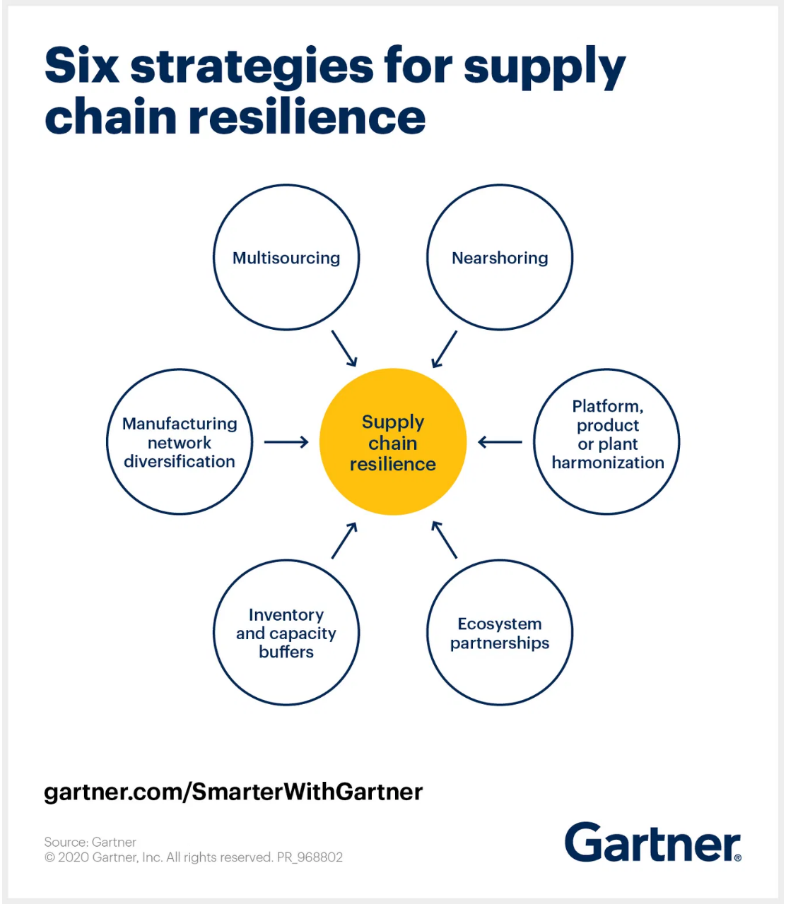
Introduction to US Supply Chain Resilience
Understanding Supply Chain Resilience
Definition:
The ability of supply chains to withstand and recover from disruptions while maintaining continuity of operations
National Security:
Critical for ensuring access to essential goods and preventing dependencies on geopolitical competitors
Economic Security:
Fundamental to price stability, business certainty, and consumer access to goods
Recent Challenges:
COVID-19 pandemic, geopolitical tensions, extreme weather events, and cyberattacks have exposed vulnerabilities
Biden Administration's Focus
Executive Order 14017:
Launched whole-of-government effort to assess and strengthen critical supply chains
"The United States needs resilient, diverse, and secure supply chains to ensure our economic prosperity and national security."
Strategic Reviews:
Comprehensive assessment of vulnerabilities in key sectors
— Executive Order 14017 on America's Supply Chains
Council on Supply Chain Resilience:
Established in 2023 to coordinate federal efforts
Historic Legislation:
American Rescue Plan, Bipartisan Infrastructure Law, CHIPS & Science Act, and Inflation Reduction Act

Slide 52

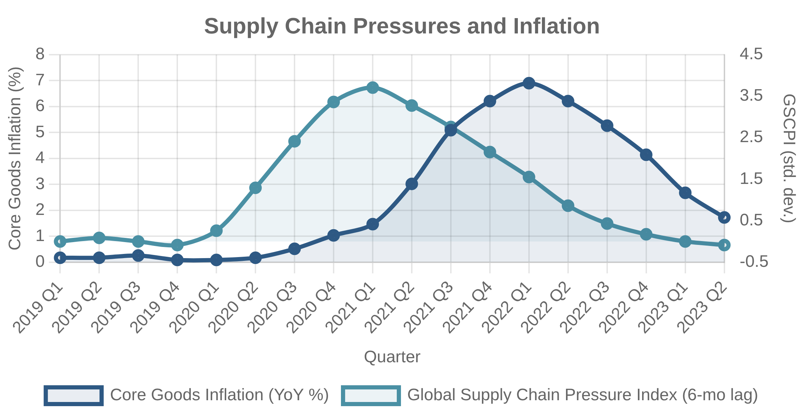
Supply Chain Vulnerabilities and Economic Impact
Structural Vulnerabilities
Decades of Globalization:
Prioritization of cost efficiency over resilience
Just-in-Time Production:
Minimal inventory buffers leave little margin for disruption
Geographic Concentration:
Critical inputs often sourced from limited regions
Underinvestment in Resilience:
Lack of redundancy, visibility, and flexibility
Historical Context
Economic Consequences
Efficiency Focus:
Supply chains optimized for cost and speed, not resilience
Inflation Driver:
Supply chain disruptions were a primary cause of post-pandemic inflation
Concentration Risk:
2011 Tohoku earthquake in Japan revealed vulnerabilities in automotive and electronics supply chains
Production Halts:
Shortages of key components led to manufacturing shutdowns
Pandemic Shock:
COVID-19 exposed unprecedented scale of supply chain fragility
Ripple Effects:
Disruptions in one sector cascade throughout the economy
Consumer Impact:
Shortages, delays, and price increases for essential goods
Economic Impact
Supply chain disruptions accounted for most of the excess core inflation in the U.S. during 2021-2023, a trend that set these pandemic years apart from the prior 20 years.

Slide 53

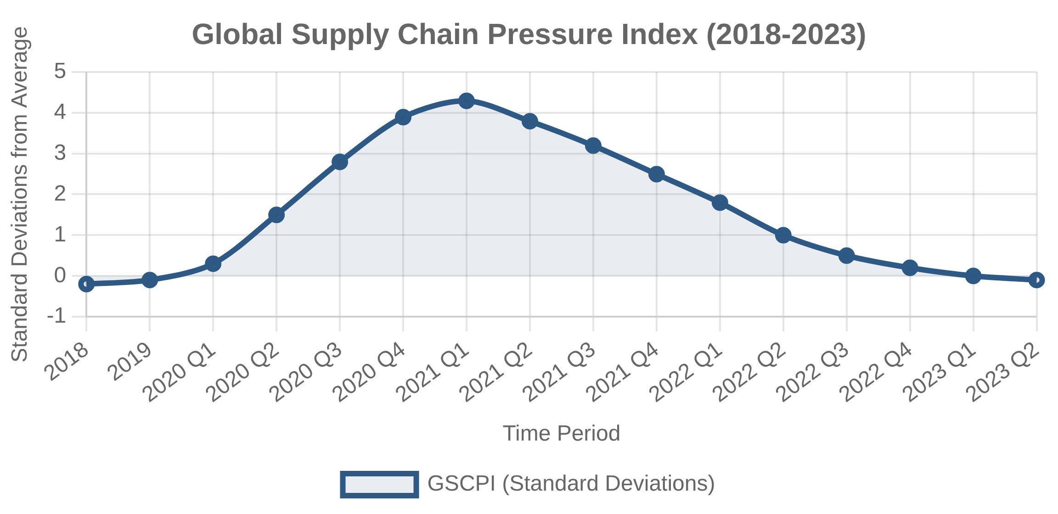
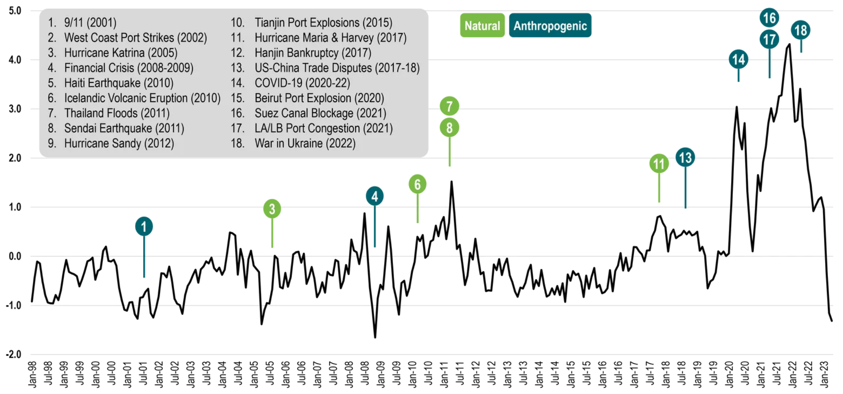
The Global Supply Chain Pressure Index
Understanding the GSCPI
Measurement Tool:
Developed by the Federal Reserve Bank of New York to quantify supply chain disruptions
Methodology:
Summarizes 27 monthly indicators of transportation costs and manufacturing surveys
Standardization:
Expressed in standard deviations from historical average
Leading Indicator:
Changes in GSCPI often precede shifts in goods inflation
Key Insights from GSCPI
Pandemic Spike:
Unprecedented disruption levels during 2021
Inflation Correlation:
Strong relationship with goods inflation
Gradual Recovery:
Steady improvement since 2022 as bottlenecks resolved
Major Events:
COVID shutdowns (2020), Suez Canal blockage (2021), port congestion (2021-22)
Peak GSCPI Value (Late 2021)
Current GSCPI Value (2023)
+4.3σ
-0.1σ
Standard deviations above average
Return to historical norms

Slide 54

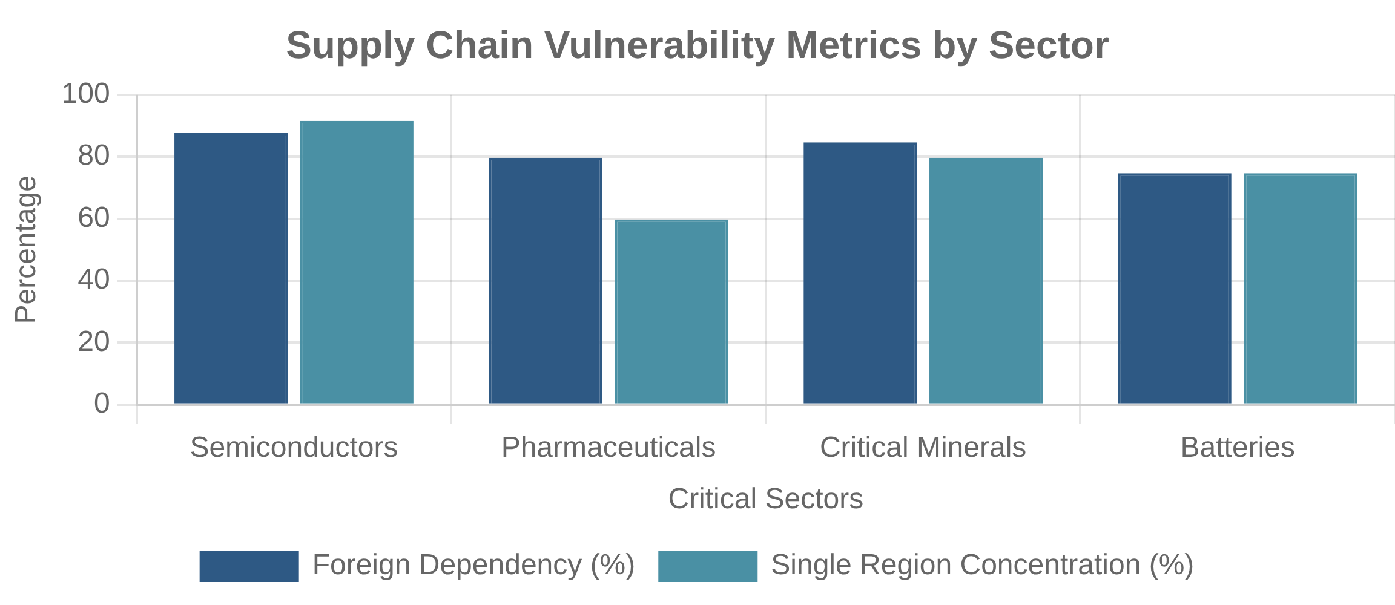
Key Vulnerabilities in US Supply Chains
Sector-Specific Vulnerabilities
Geographic Concentration
Just-in-Time Production
Semiconductors:
92% of advanced node manufacturing located in Taiwan
Critical inputs often sourced from limited regions, creating single points of failure. 75% of semiconductor manufacturing concentrated in East Asia.
Minimal inventory buffers leave little margin for disruption. Efficiency-focused approaches prioritize cost over resilience.
Pharmaceuticals:
80% of active pharmaceutical ingredients sourced from abroad
Critical Minerals:
80% of rare earth processing controlled by China
Information Asymmetries
Market Concentration
Batteries:
75% of global capacity for lithium-ion battery cells in China
Limited visibility across multi-tier supply chains. Companies often lack knowledge about suppliers beyond tier 1.
Key inputs often dominated by few suppliers. 90% of advanced packaging for semiconductors in Taiwan and South Korea.
Systemic Challenges
Underinvestment:
Decades of prioritizing efficiency over resilience
Lack of Visibility:
Limited data sharing across supply chain tiers
Workforce Gaps:
Shortages of skilled manufacturing workers
Case Study: Semiconductor Shortages
The 2021 semiconductor shortage revealed critical vulnerabilities in the US supply chain. Geographic concentration in East Asia, just-in-time production, and limited domestic capacity led to production shutdowns across multiple industries.

Slide 55

Critical Sectors for Supply Chain Resilience (Part 1)
Energy Sector Industrial Base
Includes power generation equipment, transmission and distribution systems, and grid technologies. Critical for national security, economic stability, and climate goals.
85% of solar panel manufacturing capacity located in China
Advanced Batteries
Agri-Food Supply Chains
Essential for electric vehicles, grid storage, and defense applications. Lithium-ion battery supply chain highly concentrated in China, from raw materials to cell manufacturing.
Food production, processing, and distribution networks. Vulnerabilities include concentration in processing, transportation bottlenecks, and climate impacts.
US controls less than 10% of global lithium-ion battery manufacturing
Four companies control 85% of US meat processing
Critical Minerals
Public Health and Biological Preparedness
Includes rare earth elements, lithium, cobalt, and other minerals essential for clean energy, defense, and electronics. Processing highly concentrated in China.
Medical supplies, equipment, and biological materials needed for pandemic response and public health emergencies. Includes PPE, testing supplies, and vaccines.
US relies on imports for 31 of 35 critical minerals
70% of active pharmaceutical ingredients sourced from abroad

Slide 56

Critical Sectors for Supply Chain Resilience (Part 2)
Pharmaceuticals and APIs
Semiconductor Manufacturing
Essential medicines, active pharmaceutical ingredients, and medical countermeasures. Highly dependent on foreign manufacturing, particularly for generic drugs and APIs.
Design and production of integrated circuits essential for electronics, vehicles, defense systems, and critical infrastructure. Advanced node manufacturing highly concentrated in East Asia.
80% of APIs and 40% of finished drugs manufactured outside the US
US share of global semiconductor manufacturing fell from 37% in 1990 to 12% today
Information and Communications Technology
Transportation Industrial Base
Hardware, software, and services that enable digital communications and data processing. Includes networking equipment, data centers, and cloud infrastructure.
Manufacturing capacity for vehicles, aircraft, ships, and rail equipment. Includes supply chains for parts, components, and advanced technologies for transportation systems.
90% of printed circuit boards manufactured in Asia
US auto production halted by semiconductor shortages in 2021
Defense Industrial Base
Manufacturing capacity for defense systems, weapons, and equipment. Includes specialized materials, components, and technologies essential for national security.
5,000+ critical defense components have single or vulnerable sources

Slide 57

The White House Council on Supply Chain Resilience
Establishment and Purpose
Council Structure
Established:
November 2023 by Executive Order 14110
Key Council Members
Purpose:
Coordinate federal efforts to strengthen supply chain resilience
Department of State
Department of Energy
Leadership:
Department of Treasury
Department of Transportation
Co-chaired by National Security Advisor and National Economic Advisor
Department of Defense
Department of Health & Human Services
Scope:
Whole-of-government approach spanning economic and security domains
Department of Commerce
U.S. Trade Representative
Evolution of Supply Chain Governance
Strategic Focus Areas
1
February 2021: Executive Order 14017
Supply Chain Monitoring:
Launched 100-day reviews of critical supply chains
Early warning systems and data analytics
2
June 2021: Supply Chain Disruptions Task Force
Domestic Manufacturing:
Incentives for critical sectors
Addressed immediate pandemic-related supply chain bottlenecks
International Coordination:
Partnerships with allies
3
Regulatory Frameworks:
Policies to promote resilience
November 2023: Council on Supply Chain Resilience
Permanent structure for long-term resilience efforts
Quadrennial Supply Chain Review
Published February 2024, provides comprehensive assessment of vulnerabilities and strategic roadmap for building resilience across critical sectors.

Slide 58


Legislative Support for Supply Chain Resilience
American Rescue Plan (2021)
CHIPS and Science Act (2022)
$10 billion for Defense Production Act investments
$52.7 billion for semiconductor manufacturing, R&D, and workforce
$3 billion for public health supply chain resilience
Support for small business manufacturing
25% investment tax credit for semiconductor facilities
$170 billion for scientific research and innovation
Bipartisan Infrastructure Law (2021)
$17 billion for port infrastructure and waterways
Inflation Reduction Act (2022)
$25 billion for airports to address supply chain bottlenecks
$60 billion for clean energy manufacturing
Tax credits for electric vehicles and battery production
$65 billion for broadband to support digital supply chains
Incentives for critical minerals processing
Key Supply Chain Provisions
Domestic Manufacturing:
Over $50 billion in direct investments
Infrastructure:
Modernization of transportation networks
Research & Development:
Support for innovation in critical technologies
Workforce Development:
Training programs for manufacturing skills

Slide 59


Rebuilding American Manufacturing
Manufacturing Renaissance
Key Manufacturing Initiatives
Historic Investment:
Over $1 trillion in private manufacturing investment since 2021
Semiconductor Manufacturing:
18 major facilities under construction, $200+ billion investment
Job Creation:
800,000+ manufacturing jobs added since January 2021
Clean Energy Production:
170+ battery manufacturing projects, $73 billion in investments
Strategic Focus:
Concentration in semiconductors, clean energy, and pharmaceuticals
Critical Minerals Processing:
30+ new facilities for lithium and rare earths
Manufacturing Construction
Manufacturing as % of GDP
Case Study: Semiconductor Manufacturing
+116%
11.2%
The CHIPS Act has catalyzed unprecedented investment in domestic semiconductor manufacturing. Intel ($20B in Ohio), TSMC ($40B in Arizona), and Samsung ($17B in Texas) will increase US market share from 12% to 20% by 2030.
Increase since 2021
First increase in decades
Supply Chain Resilience Benefits
Reduced Dependencies:
Decreased reliance on foreign suppliers for critical inputs
Shorter Supply Chains:
Proximity of production reduces transportation vulnerabilities
Innovation Ecosystem:
Co-location of R&D and manufacturing accelerates adaptation

Slide 60


Public-Private Collaboration for Supply Chain Resilience
Collaborative Frameworks
Key Collaboration Mechanisms
Industry Partnerships
State & Local Initiatives
Supply Chain Data Exchange:
Standardized frameworks for sharing information
Sector-specific working groups bringing together government agencies and industry leaders.
Regional supply chain resilience programs leveraging federal funding with local efforts.
Early Warning Systems:
Joint monitoring of potential disruptions
Labor Involvement
Information Sharing
Co-Investment Models:
Matching public and private capital
Workforce development partnerships to address skills gaps in critical manufacturing.
Mechanisms for sharing supply chain data while protecting proprietary information.
Case Study: Semiconductor Partnership
The National Semiconductor Technology Center brings together manufacturers, suppliers, and government. Public funding of $11B matched by industry contributions.
Benefits of Collaboration
Shared Risk:
Distributing costs across public and private sectors
Coordinated Response:
Faster reactions to disruptions
Innovation Acceleration:
Combining public research with private commercialization

Slide 61


International Cooperation on Supply Chain Resilience
Key International Initiatives
Multilateral Approaches
🇺🇸🇪🇺
US-EU Trade and Technology Council
G7 Partnership for Global Infrastructure:
$600B commitment for sustainable infrastructure in developing countries
Established in 2021 to coordinate approaches to key trade, economic, and technology issues, with dedicated working group on supply chain resilience.
Minerals Security Partnership:
11-country alliance to develop critical mineral supply chains
Supply Chain Ministerial Forum:
🇺🇸🇯🇵
US-Japan Economic Policy Consultative Committee
18 countries coordinating policies and investments
Focuses on semiconductor supply chains, critical minerals, and battery supply chains through joint R&D and investment.
🌏
Indo-Pacific Economic Framework
14-country partnership with dedicated supply chain pillar to improve transparency, diversification, and logistics coordination.
Friend-Shoring Strategy
Relocating supply chains to countries that share values and economic interests. Focuses on critical minerals, clean energy technologies, and semiconductors with trusted partners.
Benefits and Challenges
Benefits:
Diversified sourcing, shared standards, coordinated investments, and reduced duplication
Challenges:
Balancing cooperation with competition, reconciling different regulatory approaches, and managing geopolitical tensions
Future Direction:
Moving from crisis response to strategic coordination of industrial policies

Slide 62


Supply Chain Risk Management Strategies
Key Risk Management Approaches
Implementation Considerations
Supplier Diversification
Geographic Dispersion
Cost-Resilience Tradeoffs:
Balancing efficiency with redundancy in supply chain design
Expanding supplier base across multiple regions to reduce single-source dependencies and geographic concentration risks.
Distributing production across multiple locations to mitigate regional disruptions from natural disasters, political instability, or logistics bottlenecks.
Sector-Specific Approaches:
Tailoring strategies to different industries and product types
Public-Private Coordination:
Aligning corporate strategies with government incentives
Buffer Inventory
Supply Chain Visibility
Technology Enablers:
Leveraging AI, blockchain, and IoT for enhanced visibility
Strategic stockpiling of critical components and materials to ensure continuity during short-term disruptions.
Implementing technologies to track multi-tier suppliers, monitor risks, and enable rapid response to disruptions.
Case Study: Automotive Semiconductor Shortage
In response to the 2021 semiconductor shortage, automotive manufacturers have implemented multi-sourcing strategies, increased buffer inventories of critical chips, and invested in enhanced visibility systems. Ford established an early warning system that monitors 500+ key parts across 130 suppliers.
Government Support Mechanisms
Mapping Tools:
Supply chain mapping resources to identify vulnerabilities
Risk Assessment:
Frameworks for evaluating and prioritizing risks
Financial Incentives:
Tax benefits for investments in resilience
Information Sharing:
Platforms for early warning of disruptions

Slide 63


Climate Considerations in Supply Chain Resilience
Climate Impacts on Supply Chains
Climate Resilience Strategies
Extreme Weather Events
Rising Temperatures
Infrastructure Fortification:
Hardening facilities against extreme weather and investing in redundant logistics networks
Increasing frequency and severity of hurricanes, floods, and droughts disrupting production facilities, transportation networks, and raw material availability.
Heat stress affecting worker productivity, equipment reliability, and agricultural yields in key production regions.
Climate Risk Assessment:
Incorporating climate projections into supply chain planning and site selection
Supplier Diversification:
Reducing dependence on regions with high climate vulnerability
Sea Level Rise
Resource Scarcity
Resource Efficiency:
Reducing water and energy intensity to mitigate resource scarcity risks
Threats to coastal manufacturing facilities, ports, and transportation infrastructure critical to global supply chains.
Water shortages and changing agricultural conditions affecting raw material availability and production capacity.
Case Study: Semiconductor Water Resilience
Semiconductor manufacturing requires large volumes of ultra-pure water. In response to drought risks, Intel and TSMC have implemented water recycling systems that reclaim up to 90% of water used. New facilities include on-site water treatment plants and redundant supply sources.
Policy Approaches
Climate-Resilient Infrastructure:
Federal investments in ports, roads, and energy systems that can withstand extreme weather
Disclosure Requirements:
Enhanced reporting of climate risks in supply chains
Incentives for Adaptation:
Tax benefits and grants for climate resilience investments

Slide 64


Future Challenges to Supply Chain Resilience
Emerging Challenges
Strategic Considerations
Geopolitical Tensions
Balancing Resilience and Efficiency:
Finding sustainable approaches that enhance security without sacrificing competitiveness
Increasing fragmentation of the global economy into competing blocs, trade route disruptions, and export controls affecting critical technologies and materials.
Public-Private Coordination:
Developing frameworks for shared responsibility between government and industry
Non-Market Policies
International Alignment:
Industrial subsidies, state-directed investment, and other non-market practices creating uneven playing field and distorting supply chain development.
Harmonizing resilience approaches with allies while managing competition with strategic rivals
Long-term Investment:
Maintaining focus on resilience beyond immediate crises
Technological Disruption
Rapid advances in AI, automation, and additive manufacturing changing production patterns and creating new dependencies on digital infrastructure.
Workforce and Education
Growing skills gaps in manufacturing, logistics, and supply chain management limiting capacity to implement resilience strategies.
Critical Technology Dependencies
Advanced semiconductor manufacturing equipment, rare earth processing, high-capacity batteries, and pharmaceutical ingredients remain areas of significant dependency despite recent investments. These sectors require sustained focus and international coordination.

Slide 65


Recommendations for Strengthening US Supply Chain Resilience
Policy Recommendations
Implementation Priorities
Strategic Incentives
Institutional Coordination:
Strengthen the White House Council on Supply Chain Resilience
Expand targeted incentives for domestic production in critical sectors through tax credits, grants, and procurement preferences.
Data and Monitoring:
Develop supply chain mapping and early warning capabilities
Workforce Development
International Alignment:
Expand cooperation with allies on standards and investments
Invest in manufacturing skills programs, engineering education, and immigration pathways for high-skilled workers.
Small Business Support
Sector-Specific Priorities
Strengthen domestic supplier networks through technical assistance, capital access, and integration into prime contractor supply chains.
Semiconductors:
Complete CHIPS Act implementation with focus on advanced packaging
Critical Minerals:
Develop processing capacity and recycling technologies
Clean Energy:
Scale battery supply chain from materials to manufacturing
A Resilient Future
Building truly resilient supply chains requires sustained commitment across multiple administrations, close public-private collaboration, and international coordination.

